Slide 1
Mount Litera Zee School
Ghogali, Nagpur
(Academic Session 2026 - 27)
CBSE AFFILIATION NO. – 1131444
Parent Orientation Program
20th June, 2026 (Saturday)

Slide 2


Slide 3
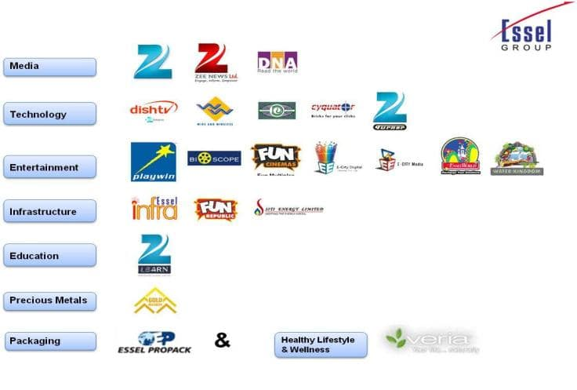

Slide 4










Zee Learn Portfolio
Vocational Education
K12 Schools
Pre-Schooling

Slide 5
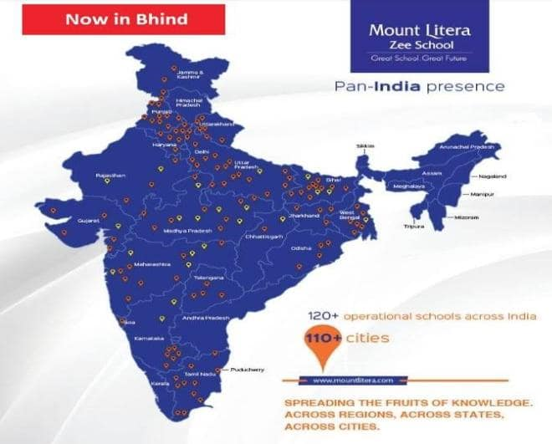

Slide 6
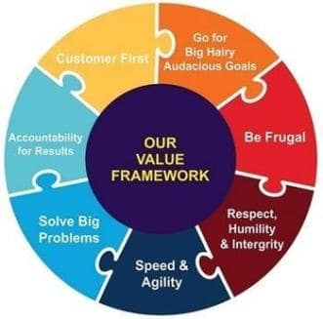
Zee Learn Vision
Statement and Core Values
“We provide the environment to ignite, nurture and unleash your potential and talent.”

Slide 7
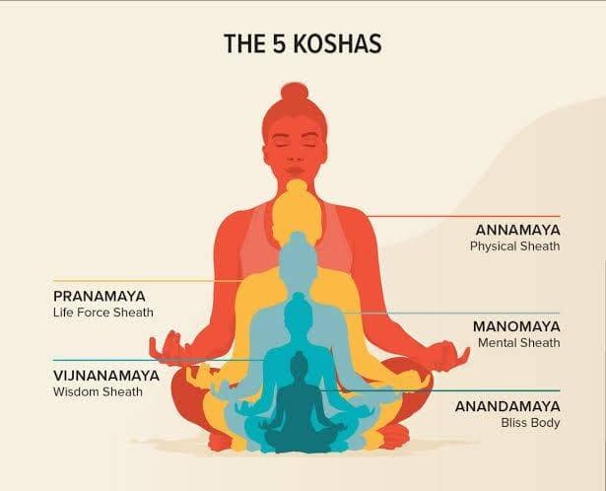
Panchakoshas

Slide 8

21st Century Skills and10-Dimensional learning
Critical thinking
Creativity
Communication
Collaboration
Citizenship
Crisis management
Computational skills
Commercial awareness
Confidence
Cultural Intelligence

Slide 9

I CARE
Child abuse free school.
School is concerned about the safety of every child.

Slide 10
MOUNT LITERA ZEE SCHOOL
GHOGALI, NAGPUR
CBSE AFFILIATION NO. – 1131444
SCHOOL CODE - 31433
ADDRESS - 23/B/3 Ghogali Opposite Pyramid City IV, Ghogali Besa Road, Nagpur- 440037

Slide 11
LET US INTRODUCE
YOU
TO
OUR MANAGEMENT & ACADEMIC TEAM

Slide 12

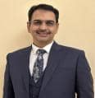
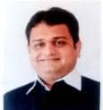
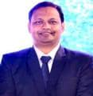
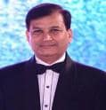
Our Management
Hon’ble Shri Poonamchand Ji Malu
CHAIRMAN
FCA Mr. Girish Malpani
DIRECTOR
Mr. Sanjay Malu
DIRECTOR
Mr. Sushil Soni
DIRECTOR
Adv. Nishant Gandhi
DIRECTOR

Slide 13
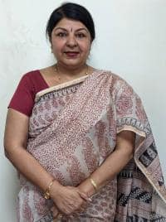
Our Mentor
Ms. Neeru Nayyer
Regional School Director
West India Zee Learn
Notes:
Trainer Notes
Please add the Regional school director details.

Slide 14
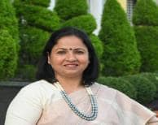
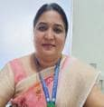






Dr. Vandana Paul
PRINCIPAL
Our Admin Team
Ms. Samta Lakhotia
Relationship Manager
Ms. Sharda Kamble
Front Office Executive
Mr. Dharam Sahu
Accountant
Mr. Abhishek Lule
Admin
Mr. Vishal Gokhale
IT Maintenance In charge
Mr. Mayur Acharya
Fleet In-charge
Ms. Monika Fulzele
Front Office Executive

Slide 15
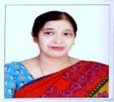
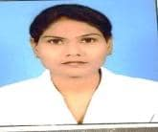
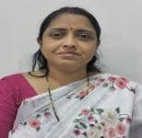
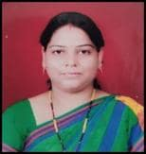
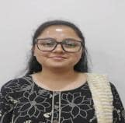
Ms. Anita Balakrishnan
Special Educator
Ms. Jayshree Meshram
School Nurse
Dr Vaishali Panekar
School Counsellor
Ms. Janvi Tekani
School Counsellor
Ms. Pradyna Hedaoo
School Counsellor

Slide 16
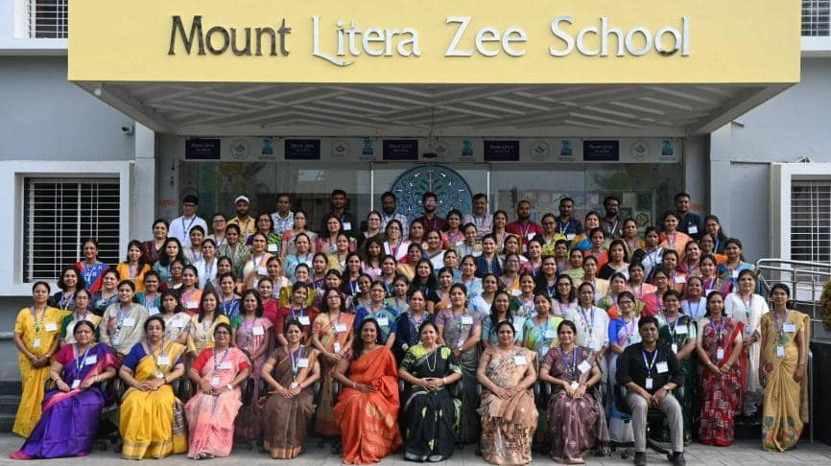
Our TEAM

Slide 17
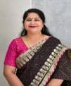

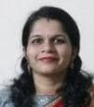
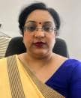

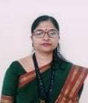
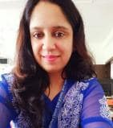
OUR Academic TEAM
Dr. Vandana Paul
PRINCIPAL
Ms. Ruchi Shrivastava
Academic Coordinator
(I-II)
Ms. Dipti Sohoni
Academic Coordinator
(III - V)
Ms. Deepa Sharma
Academic Coordinator
(VI-X)
Ms. Shweta Sathe
Academic Manager
(VI-X)
Mr. Vibhakar Vaidhya
Academic Manager
(VI-X)
Ms. Manjiri Chorghade
Exam Head
Ms. Amruta Mokhade
IT Head

Slide 18
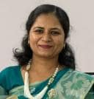
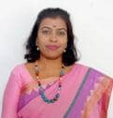
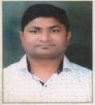
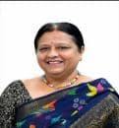
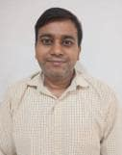
OUR Subject HODs
Ms. Shweta Sathe
English
Ms. Nasreen Hussain
Hindi
Ms. Bhagyashree Akare
Marathi
Mr. Pravin Pannase
Math
Ms. Shoumali Banerjee
Science
Ms. Amruta Mokhade
Computer
Mr. Sanjay Zade
SST
Ms. Manjiri Chorghade
Sanskrit

Slide 19
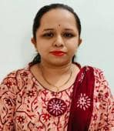
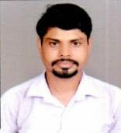
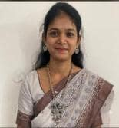
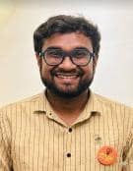
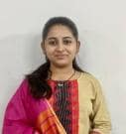
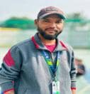
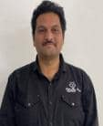
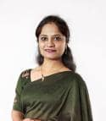
Our Co-scholastic Team
Ankita Palaskar
Art Educator
Vinit Bhoyar
Art Educator
Sneha Dondal
Dance Educator
Kunal Anandam
Dance Educator
Vaishnavi Mujumdar
Dance Educator
Satyawardhan Raut
Dance Educator
Mr. Umeshwar B
Music Educator
Rashmi Kavishwar
Music Educator

Slide 20
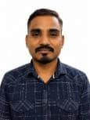
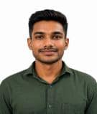
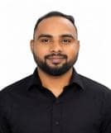
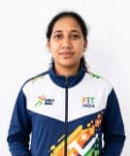
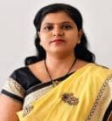
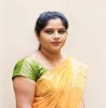
Our Co-scholastic Team
Mr.Manoj Kohare
PTI
Akshay Bansod
PT1
Mr. Sachin Borkar
PTI
Ms. Megha Dhande
PTI
Ms. Smita Makde
Librarian
Ms. Swati Shyamkuwar
Librarian

Slide 21
INFRA @
MOUNT LITERA ZEE SCHOOL,
GHOGALI ,BESA NAGPUR

Slide 22
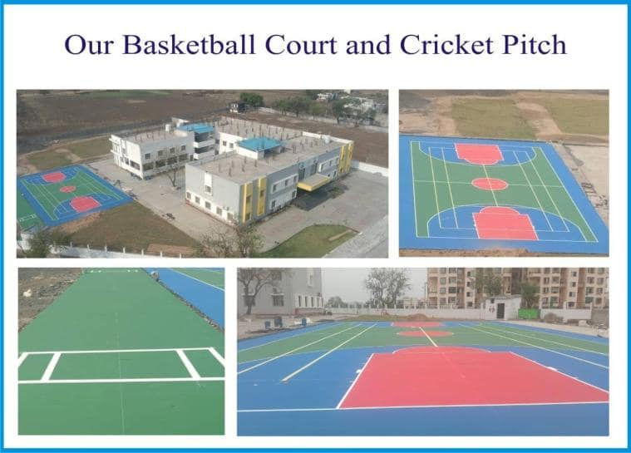
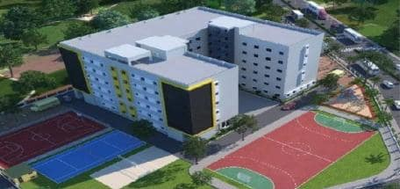

Slide 23

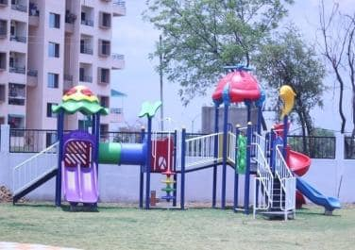
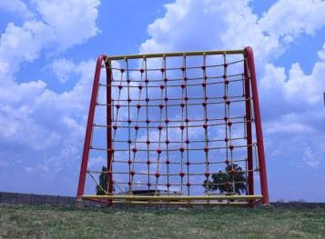
Play Area

Slide 24
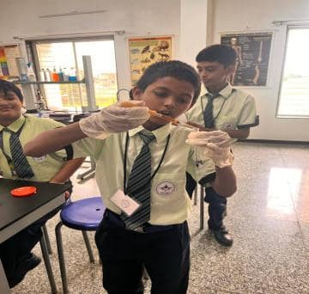
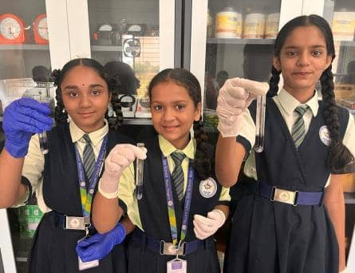
Science Lab

Slide 25
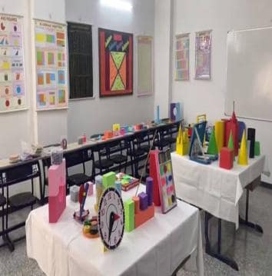
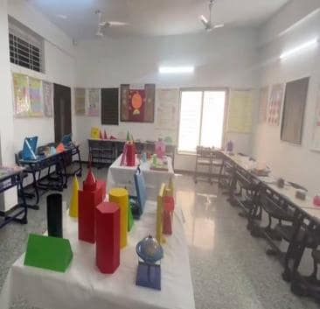
MATH Lab

Slide 26
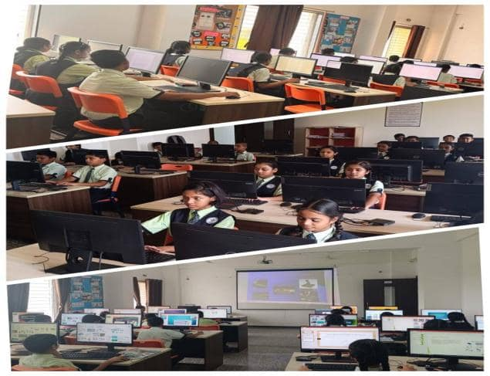
Computer Lab

Slide 27



Class Rooms

Slide 28



Co- scholastic Activity Areas.. (Music Room)

Slide 29



Co- scholastic Activity Areas.. (Dance Room)

Slide 30




Co- scholastic Activity Areas.. (Sports Room)

Slide 31


Slide 32


Glimpses
Special Days / Events/ Celebrations

Slide 33

School Reopening

Slide 34


Yoga Day & World Music Day

Slide 35

Back to School Activities

Slide 36




Club Orientation

Slide 37


Disciplined Assembly and Mass PT

Slide 38




Scout And Guide Pratham Sopan (Grade 6 onwards)

Slide 39


Scout And Guide Pratham Sopan

Slide 40


Kargil Vijay Diwas

Slide 41




Library Day

Slide 42



International Tiger’s Day

Slide 43




Student’s Council Election

Slide 44


Investiture Ceremony

Slide 45




Independence Day Celebration

Slide 46





National Sports Day

Slide 47




Basketball Match (Girls)

Slide 48





Sanskrit Diwas

Slide 49




TEACHER’S DAY

Slide 50






Slide 51






A Vibrant Celebration of Creativity Kids Fest 2025

Slide 52




Annual Function

Slide 53



Republic Day

Slide 54








Art of Story Telling Activity (CCA English Gr 6 & 7)
Resource person :Mr. Jitendra Gangwani, the Founder and CEO of Jeet Pinnacle

Slide 55




Marathi Diwas & Shivaji Jayanti Celebration

Slide 56




‘ Creatophora’ Science Exhibition

Slide 57




Slide 58


STEAM activity Plane Simulation

Slide 59


STEAM Lab Activities

Slide 60


STEAM activity(Parachute Rocket)

Slide 61

ACADEMIC ACTIVITIES

Slide 62
DSP
Day Specific Plan - (Grade I onwards)
MORAL MONDAY To inculcate Sanskar or values in children. | TRAVEL TALE TUESDAY Students will share their travelling experience(in or out of town). | WISDOM WEDNESDAY Students will talk about great leaders. Their struggles and achievements.
THOUGHTFUL THURSDAY Debate and discussion on current topics by students. | FEEL GOOD FRIDAY Students to practice stretching and breathing exercises to unwind and relax. | SPORTY SATURDAY Mass PT & meditation will be conducted.

Slide 63



Litera Nova Curriculum activities – Each day full of Learning

Slide 64


Math Lab Activities

Slide 65

National Mathematics Day

Slide 66



Science Lab Activities

Slide 67

Computer Lab Activities

Slide 68




Exam Conduction

Slide 69

Trainings /Sessions /Guidance workshops
for teachers, students and Parents

Slide 70





GENESIS
SESSION 2026 -2027

Slide 71



HO TRAINING BY RSD

Slide 72



HO TRAINING BY CSD

Slide 73



*Arti-Zee-ng* Clay Modelling Workshop

Slide 74

Committee Meetings & PTMs

Slide 75

EPTA Meetings

Slide 76


EPTA Meetings

Slide 77


Student Council Meetings

Slide 78


SMC (School Management Committee) Meeting

Slide 79


POCSO Meeting

Slide 80




POSH Meeting

Slide 81




TMC Meeting

Slide 82


Library Advisory Committee Meeting

Slide 83


Parent Teacher Meetings

Slide 84

Interschool Participations & Achievements of Students

Slide 85



Slide 86


Trishna Kamble – Grade 7
42nd National Mitsuya-Kai Karate Championship 2025
Kata- Silver ,Kumite- Gold
Maharashtra State Cadet, Junior & Sub-Junior Karate
Championship 2025- Kumite- Bronze
South Asian Karate Championship 2025, Sri Lanka
Participation
DSO Gramin- 2025 Level 1 Kumite- Gold, Level 2
Kumite- Bronze
10th NSKAI Nagpur District Karate Championship
Kata- Silver, Kumite- Silver
Awarded with the rank of Black Belt SHO-DAN and
She will be appearing for Black Belt First DAN exam in
January-2026

Slide 87

MLZS Junior Football Team-Bronze Medal
1. Vihan Donekar
2. Satwik Dhavale
3. Yuvan Kaikade
4. Virat Paul
5. Sankalp Meshram
6. Nainshu Mahajan
7. Shlok Rokde
8. Lohit Madavi
9. Aarav Shendre
10. Arsh Sharma
11. Manas Amte

Slide 88



LOKMAT GIRLS’S KHO-KHO COMPIONSHIP
Bronze Medal

Slide 89


LOKMAT BOY’S KHO-KHO COMPIONSHIP
Silver Medal

Slide 90

MLZS Ghogli U-17 Cricket Team (Boy’s)
1st Place in District
Level Cricket Championship
Participation in Division
Level Cricket Championship

Slide 91


Omkar Maind
Grade - IX
Gold Medal in Division Level Grappling
Championship at Wardha
Participation in State Level Grappling
Championship at Nasik

Slide 92

Daksh Kalbande
Grade - IX
Silver Medal in Division Level Grappling
Championship at Wardha
92

Slide 93

Shlok Gurav
Grade - X
Gold Medal in District Level Grappling
Championship at Nagpur
Participation in Division Level Grappling
Championship at Wardha
93

Slide 94

Jayash Kamble
Grade - X
Bronze Medal in State Level Grappling
Championship at Nasik
94

Slide 95

MLZS Scout and Guide State Award
Omkar Maind
Daksh Kalbande
Chetan Arode
Aaradhya Kawalkar
Shravan Taori
Atharva Borde
Devam Kale

Slide 96

3rd Position in State Level Folk Dance Competition in Nagpur
Jai Agnihotri
Shlok Rokde
Arsh Sharma
Vansh Khadse
Arnav Chide
Divydeep Bondre
Tirthesh Langote
Aaradhya Kawalkar
Nainshu Mahajanu

Slide 97

Inter Mount Litera Zee School Championship
Organized by Zee Learn @MLZS Naroli Silvasa
Vajra Choudhari
Shlok Rokde
Arsh Sharma
Vansh Khadse
Shourya Belsare
Divydeep Bondre
Tirthesh Langote
Virat Paul
Nainshu Mahajan
Rudra pahade
Kshitij Deshmane
Bronze Medal Winner

Slide 98

2nd Prize in Lokmat Inter School Dance Competition Balotsav-2025
Jai Agnihotri
Shlok Rokde
Arsh Sharma
Vansh Khadse
Arnav Chide
Divydeep Bondre
Tirthesh Langote
Aaradhya Kawalkar
Nainshu Mahajanu

Slide 99


Mount Litera Students at Akashvani
Our students performed at
Akashvani under the banner
of “Indradhanush” an Initiative
Taken by All India Radio Nagpur

Slide 100

Inter-School Competition @ Aspire
Runner Up

Slide 101

Inter-School Indian Classical Competition
1st Prize

Slide 102
Important Points To Note
To Make This Educational Journey Enjoyable

Slide 103

Subject wise Notebook List is/will be shared on MCB groups to get a better understanding about notebook division.

Slide 104




LEARNING RESOURCES

Slide 105


MLZS Enrichment Programs
DCP and FLiP – Grade III onwards

Slide 106






NOVA ITEMS
FLASH CARDS
DIY KIT
BOARD GAMES
MASK
MIND SPARKLE KIT

Slide 107







Along with Books/Notebooks following items are also provided in book kit.
Almanac
Van Declaration Form
Escort Card
Item List
Syllabus Booklet
Temporary I-card is provided with Book Kit for all the New
Admissions

Slide 108



MLZS ALMANAC
Parents are requested to fill the Declaration pages (Student copy, Teachers copy & Admin copy pg. No. 3 to 8 ) thoroughly and send the duly filled Almanac on the very first day of school.

Slide 109

Parents are requested to upload
their ward’s Passport size photo in
school uniform on MCB App.
Video tutorial will be shared.

Slide 110


ANNUAL CALENDAR

Slide 111
DOCUMENTS TO BE SUBMITTED.
For All New Admissions, Please Submit All The Documents Positively.
It Will Help Us To Register Your Child On All The Required CBSE Sites Without Any Problem.
Health Information form.
Adhaar Card
TC from last school attended
Any other pending document required

Slide 112
SCHOOL REOPENING DATE
Grade III to X
Tuesday, 30th June 2026
School Timing For Students
GRADE III to X
Monday to Friday including first day | 9:00 am to 3:10 pm
SATURDAY | All Saturdays 9:00 am to 1:00 pm Except for PTMs or any school activities.

Slide 113
TIMING FOR VAN STUDENTS ON WEDNESDAY, 1ST JULY 2026.
All the students (Pre-primary to Secondary) coming by PRIVATE VAN need to report at 9:30 am in school (Half hour late) on Wednesday , 1st July 2026.
This change of timing is done to take a photograph of students with their van and van driver so as to get clear idea of mode of transport of child.
This helps the school to ensure the safety of students who are coming by private van.

Slide 114



Slide 115
REGULAR SCHOOL TIMING
MONDAY - FRIDAY: 9:00 AM To 3.10 PM
SATURDAY: 9:00 AM To 1.00 PM

Slide 116
School’s Daily Schedule
Reporting Time for Students: 8.50 a.m.
School Assembly: 9:00 am to 9:20 am
Fruit Break 9:20 to 9:25
DSP – Day Specific Program and Supporting Period 9:25 am to 9:45 am
Three Periods (35 mins each)
4th Periods (35 mins each) Grade IV onwards/ Lunch Break for Grade I – III (11:35 am to 12:10 pm)
Lunch Break for Grade IV onwards/ 4th period Grade I – III (12:10 pm to 12:45 pm)
Fifth and Sixth period
Short Break (1:55 am to 2:00)
Seventh and Eighth period
Dispersal 3:10 pm

Slide 117


SCHOOL TIME TABLE
Time Table with subject and time allotment details and also information about which book to be brought in which period will be included in the time table especially for Primary Grades.

Slide 118







Regular School Uniform
Boys
Girls
Olive Green Shirt and Navy Blue Shorts or Trousers,
Black Velcro shoes, Navy blue socks, Tie and Belt.
Olive Green Shirt and Navy Blue Tunic / Skirt and tights/shorts.
Black Velcro shoes, Navy blue socks, Tie and Belt, Black hairbands/ clips.
Tie
Shirt
I – IV
Shorts
V – IX
Trousers
Shirt
Skirt – I to IV
V to IX
Cycling
shorts
Regular Uniform | House Uniform
Monday, Tuesday, Thursday, Friday | Wednesday & Saturday
Uniform availbale at DJ Sale Pyramid city IV Opp school Building or can be purchased from any other vendor. NEXT YEAR UNIFORM WILL BE CHANGED.

Slide 119



Winter Uniform COMMON for Boys and Girls
Winter Uniform
grade I to IV
Winter Uniform
grade V onwards
School cap for all
All students must carry a labelled raincoat and napkin in their bag during rainy season.
Umbrellas are not allowed considering the safety aspect.

Slide 120




House System & Uniform (Primary)
House colour T - Shirt and Blue Track Pants + Black shoes, Navy blue socks.
Blue House
Christopher
Columbus
Red House
Leonardo
Da Vinci
Yellow House
Albert
Einstein
Green House
Mahatma
Gandhi
Wednesday and Saturday :- House Uniform

Slide 121
Subjects Taught
Subjects for VI - X
1. English Language / Literature
2. Hindi
3. Sanskrit
4. Marathi
5. Social Science
6. Science
7. Mathematics
8. Computer
9. GK, SDG and Life Skill
10. Art and craft
11. Sports
12. Dance
13. Music
14. Library
15. STEAM Lab- Gr 6 to 8 (Aerobay)
16. DCP & FLiP- Gr 6 to 8
17. Computational Thinking & Artificial Intelligence Gr 6 to 8

Slide 122
ASSESSMENT/ EVALUATION

Slide 123


Slide 124

SOF Exams – Grade II to VIII
In-charge – Mrs. Sarita Panchware
SOF Exam Dates:
IEO- 30 September 2026
ISO- 03 December 2026
IMO- 10 December 2026

Slide 125
CCA (Co-curricular Activities) & CLUBS
CCA
Grade I & II (L1) – Every Saturday last two (4th and 5th )periods
Grade III – V (L2) – Every Saturday 2nd and 3rd periods
Grade VI - X (L3) – Club Activities only.
CLUBS-
Literary Club , Eco Club, Creative Club, Fitness Club, Speech and Drama Club, Heritage Club

Slide 126
Birthday Policy
If the students want to celebrate their birthday in school, they may bring any small chocolate of value Rs. 2 or Rs. 5 . In case if it is found having more value, the entire packet will be returned.
Parents are requested not to give any fancy/gold/silver gift or token of gratitude to the educators.
No birthday parties will be held in school.
No birthday gifts or return gifts will be exchanged with students.
Private birthday invitations should not be sent in school.
Send your child in decent dress along with I-card.
Long gowns/frocks and fancy items are not allowed.

Slide 127

Transport Facility

Slide 128
MODES OF TRANSPORT
1. School Transport Facility is available in school.
Fleet In-charge – Mr. Mayur Acharya 78880 18773
2. Parents availing private van for their ward are requested to fill the Van Declaration Form (to be given with the book set) and submit it compulsorily on the first day of school.
3. Parents/Van drivers coming to collect their ward to please carry Escort card.
4. To keep a track of students coming to school by van, on the First day of school, please send the students at 9.30 am. School will take photograph of van students with their respective van and van drivers on the first day itself (For safety purpose).

Slide 129
Transport Facilities provided by school-
All the buses are approved by RTO as per the Motor Vehicle Act specially made for school buses.
Drivers and Lady Conductors to wear Uniform and follow safety rules.
GPS system with camera & panic button are installed in each buses.
Seat adjacent to jack knife door are rear facing to prevent the children from falling through the door.
A fully equipped First-Aid Box is there in the bus.
All the buses have Speed Governor approved by RTO as per the Motor Vehicle Act specially made for school buses.
Special training is provided to the drivers and conductors and review would be taken after every quarter.
GPS tracking app access is provided to the parents.
We provide Messaging Notification on Pick-up and Drop point to the Parents.

Slide 130




GPS tracking application access

Slide 131
Code of Conduct for Parents
Show respect and support for your child, the educators, and the school.
Do not talk ill about any educator or school authority in front of the students.
Have positive attitude towards the school and cooperate with the teachers towards the betterment of the student.
Develop reading habit in your child by example.
Support the school’s discipline policy.
Encourage the child to be regular and punctual in attending the school.
No half day is allowed to any child unless there is an emergency.
Please do not send any costly item or accessories with the child. (This is for his/her own safety.

Slide 132
Health And Hygiene
In some cases, if the medical attention is required, please keep the authorities of the school informed in writing at all times with doctor’s prescription attached.
No student should attend school if he/she is suffering with serious or contagious disease. They will be allowed to attend the school again when a medical certificate is produced.

Slide 133

PARENT – SCHOOL/
SCHOOL – PARENT
COMMUNICATION
This Photo by Unknown Author is licensed under CC BY

Slide 134

School to Parent Communication
All school related communication will be done through school portal MCB (My Class Board) ONLY. All Daily Logs/ Class Diary, assignments and announcements will be posted in MCB daily. Parents are requested to check the MCB app daily.
Grade wise What's app community group will be used ONLY in case of emergency.
Please download MCB App from play store.
Username and Password (Both are same) for MCB is mentioned on left hand side corner of your fee receipt. (Enrollment No.)

Slide 135


DAILY LOG BOOK

Slide 136


Communication through ALMANAC
For Parent – Teacher communication, please write to Grade Educator through
Almanac on page no. 32 & 33.
Grade Educator/ Subject Educators to Parent communication, teacher will send the message through Almanac which has to check and signed daily by the parents. (Almanac pg. no. 34 & 35)

Slide 137
PTMs - Secondary
Grade VI to X
PTM 1: 11th July, 2026
Transition Guidance Gr VI : 17-07-2026
PTM 2: Paper Showing - Gr VI to X : 29-08-2026
PTM 3: PT2 Paper Showing Gr IX , X : 17-10-2026
PTM 4 -OPEN Day VI to X Term 1: 31-10-2026
PTM 5: PT-3 Paper Showing (Gr. IX, X) : 19-12-2026
Preboard-I Paper Showing (Gr. X): 16-01-2026
Preboard 2 (Gr. X) Paper Showing: 29-01-2026
PTM 6: PT2 Paper Showing (Gr. VI-VIII) – 30-01-2027
Paper Showing YE - Grade IX- 05-03-2027
Paper Showing Grade V to VIII : 03-03-2027

Slide 138
Parent to Teacher/Admin Staff Meeting Time other than regular PTMS
Designation | Working Time
SCHOOL OFFICE TIMING | 9:00 am to 5:00 p.m.
Timing for Parents to meet teachers | All PTMs All working days 3:30 p.m. to 4:00 p.m. (With prior appointment)
Timing when parents can meet co-ordinators | Monday – Friday 3:30 p.m. to 4:00 p.m. All working Saturdays between 1:30 p.m. to 2:30 p.m. (With prior appointment)
PRINCIPAL | 2:30 p.m. to 3:30 p.m.
Note: Please take a prior appointment for any sort of meeting.

Slide 139
CONTACT NUMBERS FOR
PARENT - SCHOOL COMMUNICATION
FRONT DESK – Ms. Sharda Kamble - 7888018774/ 7888018771
( 0712-2956469 / 0712-4067294 )
ADMIN – 7888018770
TRANSPORT – 7888018773
CO-ORDINATOR MS. RUCHI SHRIVASTAVA (Primary 1 - 2) - 7888018187
CO-ORDINATOR MS. DIPTI SOHONI (Primary 3 - 5) – 7888018183
CO-ORDINATOR MS. DEEPA SHARMA (Secondary 6 - 10) – 7888018189
CO-ORDINATOR MS. VIBHAKAR VAIDYA (Co-scholastic) –9911740741
PRE – PRIMARY - 7888018099
*Timing to call coordinator for parents is between 10:00 am to 11:00 am after which they can WhatsApp msg on the above-mentioned numbers. All messages will be responded within 24 working hours.

Slide 140
I.T. INFORMATION AND GUIDANCE
APPS AND SOFTWARE
Session by Amruta Mokhade

Slide 141



Litera Hub
(Litera Nova App)
Key Highlights:
Extended Learning support for students
Available for grade 1 to 10
Can work on multiple devices at a same time
Available on Google Playstore, iOS and weblink is also available for laptops.
Litera Nova Junior
Litera Nova Junior
Login details will be provided from school within one week after school reopening, on Page 7 of School Almanac.

Slide 142






Nova Content
PDF Content
Video Content
Audio Content

Slide 143



Personalized Learning- Nova App
More tab in app
ASKNOVA – 24 hours chatbot
  NOVA EXPERT – experts solve doubts
  SIM NOVA – simulations for hands on learning (Grade 6 onwards)
  ASKNOVA – 24 hours chatbot
  NOVA EXPERT – experts solve doubts
Notes:
Zen: Super Boy offers a personalized learning experience tailored to your unique style, interests, and hobbies. Perform a quick test on the app to receive your customized learning plan. The app features an easy-to-use interface and unique learning plans just for you.
Original Content:
Zen: Super Boy:
It is designed to match YOUR Unique Learning Style, your choice, your interest, and your hobbies!” Perform a quick test and grab your personalised and Unique learning plans on the App.

Slide 144


Mind Sparkle AR Flashcards
Interactive Learning Experience
  Scan the flashcards to bring lessons to life
  Engage with 3D stories, quizzes, and facts
Educational and Fun
  Combines learning with entertainment
  Encourages active participation
Innovative Technology
  Augmented Reality enhances the learning process
  Provides a unique and immersive experience
Locating
AR Nova: Games
in Nova app
Notes:
Mind Sparkle AR flashcards offer an interactive learning experience. Scan them to see 3D stories, quizzes, and facts. They combine education with fun, encouraging active participation through augmented reality.
Original Content:
Zara: Super Girl: [Holding AR flashcards- Mind Sparkle kit]
"These Mind Sparkle AR flashcards bring lessons to life! Scan them, and watch stories, solve quizzes and facts pop out in 3D!" Learn and have fun!

Slide 145

Digital Flipbooks
Interactive Learning
  Engage with stories, poems, and diverse topics
  Enjoyable and creative exploration
Pronunciation Practice
  Touch words to learn their pronunciation
Multimedia Experience
  Watch or listen to enhance learning
Notes:
Digital flipbooks offer an engaging way to explore stories, poems, and various topics. They help with pronunciation and provide a multimedia learning experience.
Original Content:
Zara: Super Girl: [Pointing to a flipbook on a table, turning pages]
"Digital Flipbooks let you explore stories, poems, and diverse topics in an enjoyable and creative way. Touch and learn pronunciation of each word. Watch or listen and learn!”

Slide 146


My Class Board
*My Class board is a communication app for parents using which they can download school announcements, Class Diary, Class assignments, Events.
* MCB app will be used to pay School Fees.
*The app is available for both Android and iPhones.

Slide 147





My Class Board – Parent Portal
Class Diary
Menu Page
Announcements
Assignments
MCB Menu icon
Notes:
This presentation was automatically generated by PowerPoint Copilot based on content found in this document:
https://zeelearnltd1-my.sharepoint.com/personal/paromita_chattopadhyay_zeelearn_com/_layouts/15/Doc.aspx?sourcedoc=%7BDDB65EBD-FD2E-48A5-98B7-09F7CA5CBA28%7D&file=Script%20for%20Litera%20%20Curriculum.docx&action=default&mobileredirect=true&DefaultItemOpen=1

Slide 148


Know more about us
Mail-Id – mlzs.ghogali@mountlitera.com
School Website :
www.mountliteraghogali.com
Facebook Page:
https://www.facebook.com/mountliterabesa/
You Tube Channel :
https://www.youtube.com/channel/UCAR4GcspgghrllvzTncGgmg
Instagram handle https://instagram.com/mlzs_besa?igshid=MzRlODBiNWFlZA==

