Slide 1


Parent Orientation Programme
Academic Year 2024-25
Pre-Primary
Mount Litera Zee School
Ghogali Besa, Nagpur
Date: 15th June 2024

Slide 2
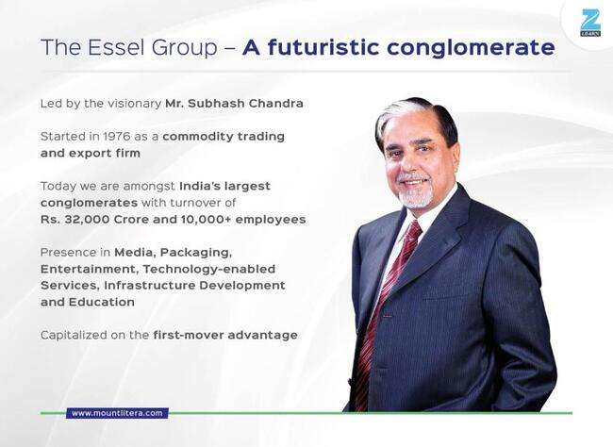

Slide 3


Slide 4
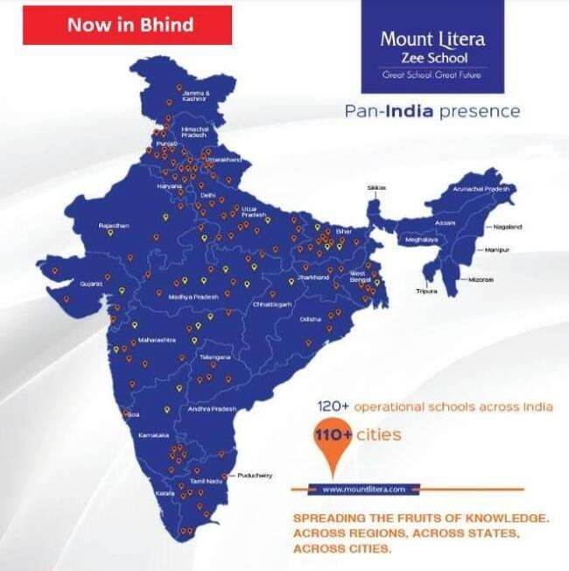

Slide 5

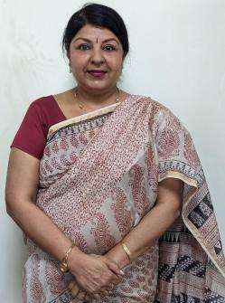
Our Mentor
Ms. Neeru Nayyer
Regional School Director
West India Zee Learn
Notes:
Trainer Notes
Please add the Regional school director details.

Slide 6
Our Belief System
Children are not just roll numbers, they are unique individuals
Every child is talented. Schools just need to figure where that talent lies
A school’s role is to develop whole individual, not just complete the syllabus
Holistic development needs partnership between School and Parents
Schools need an integrated approach centered on the child

Slide 7
Our Philosophy
Every aspect, action and decision at Mount Litera Zee School is governed by a single, simple principle –
“What’s Right for the Child (WRFC)”.
We help students achieve the Emerging Student Profile (ESP) we identified
We nurture the unique potential of children
We do what is right for the child (WRFC)

Slide 8
Our Vision
“ To create an excellent educational institution
synthesising the human values with the
highest quality of teaching – learning using
modern technology-driven tools for preparing
a well-rounded personality for our society.”
To shape global minds on the Indian soil. To ensure this, the school will give every student an access to world class infrastructure and innovative curriculum that promotes the all round development of the child imbibing traditional values.

Slide 9

Emerging Student Profile
Notes:
Trainer Notes
Life Skills
Life Skills are critical for leading life powerfully. Our students emerge out of school with the following life skills. We build life-skills through specially-designed life skills classes, subject-integrated activities, Litera Clubs.
Effective Habits: Our character is a composite of our habits. Mount Litera Zee Schools have a series of programs and activity systems that build effective habits for life.
Media Literacy: Media literacy develops the ability to analyse, critique and effectively use various media to find more information and make informed decisions.
Aesthetic Sense: Aesthetic sense helps students appreciate the beauty that exists around them and enables them to contribute to it.
Metacognition: Metacognition is the skill of knowing how we learn and our unique styles of learning. This empowers us in removing the hidden barriers to our learning.
Risk Taking : This skill enables making your own decisions at the risk of making a mistake, instead of doing what you are told to by others.
Self-Development: An important goal in education is to foster self-reliance and independence. Self-development plans are used for teaching students to complete tasks independently and take an active role in monitoring and reinforcing their own behaviour.
Knowledge
Knowledge, as defined at Mount Litera Zee School, goes beyond the traditional boundaries of academic learning. Our students gain knowledge in the following areas.
Higher-Order Thinking Skills (HOTS) : Students gain real understanding of the subject they take. This enables them to not only retain and apply concepts but also to create new knowledge and ideas from their understanding.
Sports : Students are encouraged to take up sports not only for fitness and health but also to ingrain the values of sportsmanship and teamwork.
Art (Fine Arts, Performing Arts and Applied Arts) : Students develop proficiency in one or more art form.
Entrepreneurship and Financial : Students are encouraged to see the world as an owner. They develop an ability to reach a goal by making choices and planning necessary actions. Students also develop a strong and empowering relationship with money and money management practices.
Core Values
LIFE SKILLS
KNOWLEDGE
CORE VALUES
Core values function as the foundation of leadership. Our students will role model these values. We firmly believe that values cannot be taught in a classroom and that's why we promote an ecosystem that sustains and nurtures these values.
Integrity : Integrity does not only mean being honest. Integrity means being true to oneself and acting in respect of values that one holds. Integrity is displayed in how teachers and students share information, plan and work on assignments, and how the school system handles commitments and decisions.
Open Mindedness : To have an open mind means to be willing to consider or receive new ideas and people with different outlook. It means being flexible, adaptive, and accepting the fact that'others could be right with their differences too'. This value encourages people to seek to understand before expecting to be understood. Cultivating an open mind is another valuable outcome of critical thinking and reasoning; an open mind helps us expand our horizons and be more diverse and inclusive.
Authenticity : It is the alignment of head, mouth, heart, and hands - thinking, saying, feeling, and doing the same thing consistently. This builds trust and sense of cooperation.
Humility : The very basic requirement in a leader because people feel comfortable around a person who pays attention to them and is considerate. Respecting others brings it around to oneself too. Such a person is happier and has more friends. This helps relate to others and their situations and thus deal with them better.
Growth Mindset : Students with a growth mindset believe that their intelligence can be developed over time through their own effort. They know that while not everyone has the same kind of intelligence, everyone can learn and improve. The growth mindset helps children focus on their efforts. They are free to concentrate on becoming smarter rather than looking smart.
Compassion : Inculcating compassion can make our students aware of the world around them and it teaches tolerance towards different cultures and personalities. This enables children to be more sensitive and caring, that in turn leads to better relationships with others as they grow into adulthood.

Slide 10
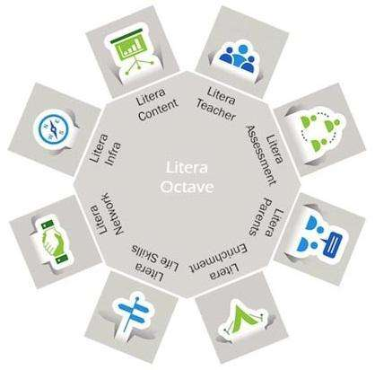
Litera Octave
Unique Child – Centric Teaching Process
Notes:
Trainer Notes
How do we achieve the - Broad based Learning i.e. CONTENT and Behavioral Outcomes, i.e. ESP?
Through the Litera Octave –
1. Litera Teacher - Equipped with the 13 attributes
2. Litera Assessment - Centrally conducted exams for grade 1 – 12
3. Litera Parent - Seminars, PTM and Workshops to make effective partners_+ Career Guidance
4. Litera Enrichment - Litera Content, Co-curricular and extra-curricular activities
5. Litera Life Skills - Activities that hone the Multiple Intelligences
6. Litera Network - Collaborative Learning within the Network
7. Litera Infra - Classrooms enabled with IWB, Computers, Projectors, Labs, Library, MLL APP, TAT Modules, Epfuture
8. Litera Content - Blended Learning Design & Litera Content-on academic & Enrichment programs and Assessment and Evaluation

Slide 11

I CARE
Child abuse free school.
School is concerned about the safety of every child.

Slide 12
LET US INTRODUCE YOU
TO
OUR MANAGEMENT & ACADEMIC TEAM

Slide 13
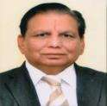
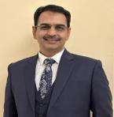
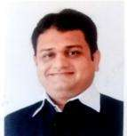
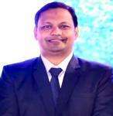
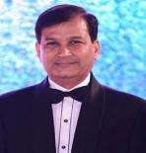
Our Management
Hon’ble Shri Poonamchand Ji Malu
CHAIRMAN
FCA Mr. Girish Malpani
DIRECTOR
Mr. Sanjay Malu
DIRECTOR
Mr. Sushil Soni
DIRECTOR
Adv. Nishant Gandhi
DIRECTOR

Slide 14
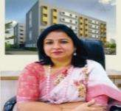
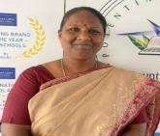
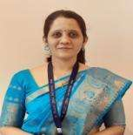
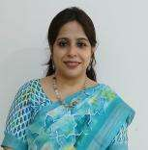
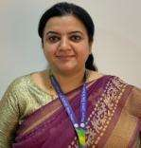
OUR Academic TEAM
Dr. Vandana Paul
PRINCIPAL
Ms. Jayanti Iyer
VICE PRINCIPAL
CO-ORDINATORS
Ms. Dipti Sohoni
Academic Coordinator
(I - III)
Ms. Ifrah Ahmed
Academic Coordinator (IV - VII)
Ms. Megha Pathak
Academic Coordinator (VIII onwards))

Slide 15
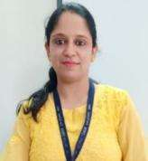
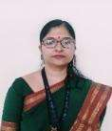
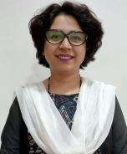
Extended Heads
Ms. Amruta Mokhade
IT Head
Ms. Manjiri Chorghade
Time Table In Charge
Exam Head
Ms. Sarika Thomas
Time Table In Charge
Event In Charge

Slide 16
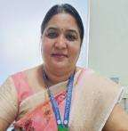
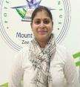

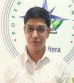
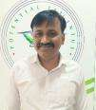
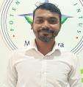
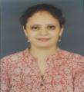
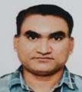
OUR Admin TEAM
Ms. Samta Lakhotia
Relationship Manager
Ms. Sharda Kamble
Front Office Executive
Ms. Debasmita Mukherjee
Admin
Mr. Dharam Sahu
Accountant
Mr. Abhishek Lule
Admin
Mr. Vishal Gokhale
IT Maintenance In charge
Ms. Anthara Gandhi
Front Office Executive
Mr. Parmanand Mate
Fleet In-charge

Slide 17
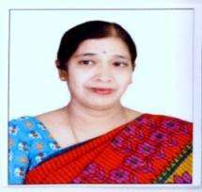
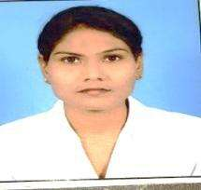
Extended Staff
Ms. Anita Balakrishnan
Special Educator
Ms. Jayshree Meshram
School Nurse

Slide 18
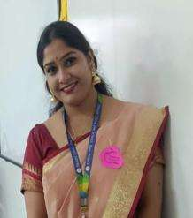
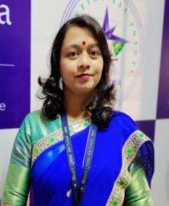
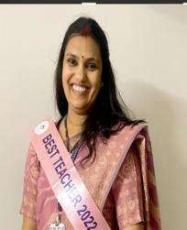
OUR Gradewise Leaders
LEADERS (PRE-PRIMARY)
Ms. Pranali Hiranwar
Leader (Nursery)
Ms. Renuka Deshmukh
Leader (Junior Kg)
Ms. Pooja Gandhi
Leader (Senior Kg)

Slide 19
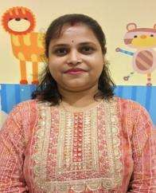
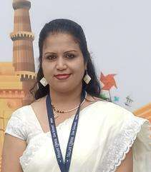
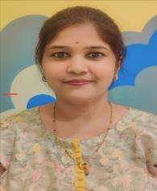

OUR Grade Educators
NURSERY GRADE EDUCATORS
Ms. Supriya Chatterjee, Swati Nimawat
Nursery A
Ms. Kranti Wakekar, Pranali Hiranwar
Nursery B

Slide 20
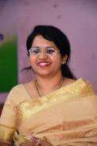
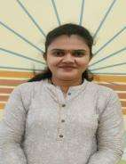
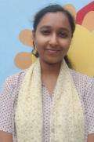
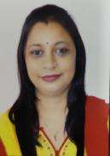
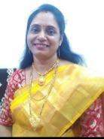
JUNIOR KG GRADE EDUCATORS
OUR Grade Educators
Ms. Arpita Munje
Ms. Ashwini Padoliya
Ms. Alphia Aiyub
Ms. Shilpa Borundiya
Junior KG A
Junior KG B
Ms. Renuka Deshmukh
Ms. Smita Vairagade
Junior KG C

Slide 21
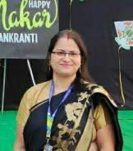
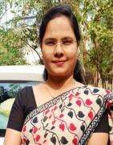
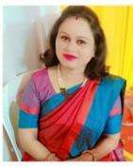
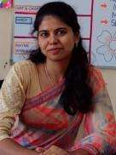
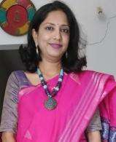
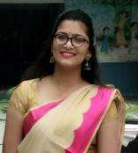
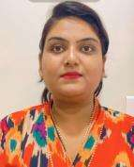
SENIOR KG GRADE EDUCATORS
OUR Grade Educators
Ms. Shipra Chatterjee
Ms. Samiksha Gawai
Ms. Priti Divekar
Ms. Shivani Kale
Senior KG A
Senior KG B
Ms. Sachi Kamble
Ms. Natasha Khandelwal
Ms. Vaishali Bhagat
Ms.Pooja Gandhi
Senior KG C
Senior KG D

Slide 22
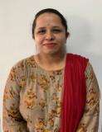
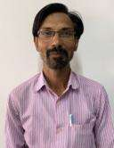
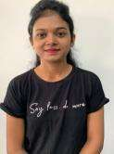
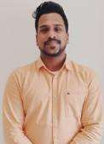
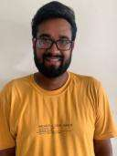
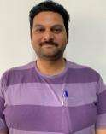







COSCHOLASTIC TEAM
Ankita Palaskar
Art Educator
Atul Thakre
Art Educator
Sneha Dondal
Dance Educator
Aditya Gandhi
Dance Educator
Kunal Anandam
Dance Educator
Umesh Barapatre
Music Educator
Bakul Meshram
Librarian
Monika Singh
Librarian
Smita Makde
Librarian
Manoj Kohare
PTI
Akshay Bansod
PTI
Savita Deshmane
PTI
Pranay Umate
PTI

Slide 23

Our TEAM

Slide 24
ACCOMPLISHMENTS BY
VISIONARY LEADERS

Slide 25



“STUDENT OUTREACH CHAMPION AWARD”
by Litera Verse
RECEIVED BY OUR DIRECTOR FCA MR.GIRISH MALPANI

Slide 26
AWARDS RECEIVED BY PRINCIPAL MLZS Ghogali Besa, Dr. Vandana Paul

Slide 27

Received Nachiketa Award for the most innovative idea at the hands of Deputy Chief Minister of Maharashtra
Shri Devendra Fadnavis on the Topic
“To Bring out Harmony through Education”
at Principal’s Conference in 2015

Slide 28

Received Super Nachiketa Award
for effective implementation of
Innovative idea at the hands of
Mr. Sonam Wangchuk ( An Education Reformist and Architect of Sustainable initiatives in Laddakh)
in Principals’ Conference 2019

Slide 29




A Master Trainer of CBSE and has trained more than 200 teachers on the topic “Classroom Management”

Slide 30


Principal MLZS Besa, Dr. Vandana Paul, receiving
“Best Paper Presentation Award” at IPEC 2023

Slide 31



MIMAMSA “A Principal’s Conclave & School Awards”

Slide 32



Principal, Dr. Vandana Paul ma’am guiding young students at MKH Sancheti School on Mental Wellbeing

Slide 33
INFRA @
MOUNT LITERA ZEE SCHOOL,
GHOGALI BESA NAGPUR

Slide 34



Slide 35


Play Area

Slide 36

Classroom – Pre-Primary

Slide 37



Co- Scholastic Activity Areas (Music Room)

Slide 38



Co- Scholastic Activity Areas (Dance Room)

Slide 39




Co- Scholastic Activity Areas (Sports Room)

Slide 40





Illume Room

Slide 41
TEACHER TRAINING GLIMPSES
2023-2024

Slide 42


Staff Orientation & Training ( Zee HO)

Slide 43


EP FUTURE (IT) TRAINING BY HEAD OFFICE

Slide 44


Guidance to Teachers by Dr. Kingston D’Souza (Academic HEAD, Zee Learn)

Slide 45


PENTEMIND TRAINING PRE PRIMARY

Slide 46

Know the Unique Potential of Children

Slide 47
Children are observed and assessed for all the developmental milestones, namely :
Overall Development
Cognitive development
Language development
Creative development
Personal, Social & Emotional development
Physical development
Gross & Fine

Slide 48
Glimpses of
Academic Year 2023-24
Pre -Primary
Special Days/Events/Celebrations

Slide 49


Parent Orientation

Slide 50


Happy Hour (Pre-Primary & Grade I-II)

Slide 51
Happy Hour
First day of the school is a new experience for every child. It is a transition period for Pre-Primary and Grade I students as they will be introduced to new environment and new Grade Educator for the first time. To make them familiar with this new environment school has planned an Initiative i.e. “Happy Hour”.
During this hour, child will get familiar with Grade Educator, school staff, school premises and new friends to build socio-emotional skills.
Please note the schedule for the same.
21st June, 24th June, 25th June, 26th June, 27th June and 28th June
Timing: 10:00 am to 11:00 am.

Slide 52

FIRST DAY OF THE SCHOOL

Slide 53

LANGUAGE ACTIVITY

Slide 54

FLOAT AND SINK ACTIVITY

Slide 55

GERMINATION ACTIVITY

Slide 56


Van Mahotsav
International Tiger Day

Slide 57


SUNFLOWER MAKING ACTIVITY

Slide 58

Rakhi Making

Slide 59

Dental Check-up Camp

Slide 60

GRATITUDE CARD

Slide 61


LUNCH IN GARDEN

Slide 62


CHILDREN’S DAY CELEBRATION

Slide 63

JANMASHTAMI

Slide 64


POLA CELEBRATION

Slide 65


VASANT PANCHMI

Slide 66


Diwali Celebration

Slide 67


HOLI CELEBRATION

Slide 68


MAKAR SANKRANTI

Slide 69


SING ALONG SESSION 2023 - 2024

Slide 70

GRANDPARENTS DAY

Slide 71

Peace Day

Slide 72



SPECIAL ASSEMBLY

Slide 73

FELICITATION

Slide 74



Sports Day

Slide 75





Slide 76

CCA Information
Show & Tell
CCA- Co Curricular Activity
will be conducted in class.
Every child will get a chance
to participate in CCA.
Appreciation will be given to
all the participants.

Slide 77


Academic Performance
Academic Performance is conducted thrice a year. The motto is to boost the child’s confidence and ensure every child should get a chance to speak. Topics will be provided by the Class Educator.

Slide 78

Academic Performance –

Slide 79



CULMINATION (Pre-Primary)

Slide 80


GRADUATION DAY (Pre-Primary)

Slide 81





Graduation Day Celebration

Slide 82



CLASS PHOTOGRAPHS PREPRIMARY

Slide 83

Book Set Pre-Primary
Books, notebooks (Sr. KG), Book list, Temporary I-card (For new admissions), Escort Card, Van Declaration form, Stationery Requirement List will be given with the Book Kit.
Dates for book submission of :
Pre-primary : 28th , 29th JUNE (Friday & Saturday)
Time: 10 a.m. to 2 p.m.

Slide 84
SUBJECTS -Pre Primary
Language
Literacy
Numeracy
Knowledge
Hindi
Mental Might
Readiness
Artsy
Dance
Music
Sports

Slide 85
NURSERY STATIONERY REQUIREMENT
Sr. No. | Name of item | Colour/size/ quantity per student
1 | Tinted sheet | Black – 3 Brown – 2
2 | A-4 size papers | 1 packet
3 | Origami papers | 1 packet
4 | Fevicol bottles | 2 bottles ( 20Rs /-)
5 | Bindi packet | Big size
6 | Poster colour | Yellow and Green
7 | Slate pencil | 1 packet
8 | Pencil box , Erasers , 2 Sharpners | 1 pencil box , 2 erasers , 2 sharpeners
9 | Crayon box | 1

Slide 86
JUNIOR KG STATIONERY REQUIREMENT
Sr. No. | Name of item | Colour/size/ quantity per student
1 | Tinted sheet | Red, yellow , orange, blue, green – each 1
2 | A-4 size papers | 1 packet
3 | Origami papers | 1 packet
4 | Fevicol bottles | 2 bottles ( 20Rs /-)
5 | Bindi packet | Big size
6 | Poster colour | Red and blue
7 | Slate pencil | 1 packet
8 | Pencil box , Erasers , 2 Sharpners | 1 pencil box , 2 erasers , 2 sharpeners
9 | Crayon box | 1 unit

Slide 87
SENIOR KG STATIONERY REQUIREMENT
Sr. No. | Name of item | Colour/size/ quantity per student
1 | Tinted sheet | NEON COLOURS violet, light green ,yellow, fluorescent pink and orange, – each 1
2 | A-4 size papers | Neon colours - 1 packet
3 | Origami papers | 1 packet
4 | Fevicol bottles | 2 bottles ( 20Rs /-)
5 | Bindi packet | Big size
6 | Poster colour | White and dark pink
7 | Pencil box , Erasers , 2 Sharpners | 2 pencil box , 2 erasers , 2 sharpeners
8 | Crayon box | 1 unit

Slide 88

MLZS ALMANAC - PrePrimary
Almanac is a tool for communication between the parent and school. All school information will be sent through the Almanac.

Slide 89
Pre Primary
Period Distribution and Timing (Monday to Friday)
Time | Activity
9:00a.m.-9:20a.m. | Assembly
9:20a.m.-9:30a.m. | Recapitulation
9:30a.m.-10:15a.m. | Concept
10:15a.m.-10:45a.m. | Art Craft/Music/Dance
10:45a.m.-11:30a.m. | Break
11:30a.m.-12:10p.m. | Concept
12:10p.m.-12:25p.m. | Circle Time
12:30p.m. | Dispersal
Kindly note that the timetable is subject to changes as per the child’s pace and flexibility.

Slide 90
Weekly Activities Schedule- PREPRIMARY
Date & Day | Subject | Topic
27.02.2023 Monday | EVS | Land and Water on Earth.
 | Math | Recap of number names ‘One to Four’.
 | Hindi | आकृतिके ऊपर घुमाइए और लिखिए.
 | English | Dictation. Revision of all previous rhymes.
 | Talk Time | We all work together.
28.02.23 Tuesday | EVS | National Symbols of India.
 | Math | Missing Numbers.
 | English | Introduction – 3 letter words formation. Revision of all previous rhymes.
01.03.2023 Wednesday | EVS | Sun, Moon and Stars.
 | Math | Introduction of Number Name ‘Five’.
 | Hindi | आकृतिके ऊपर घुमाइए और लिखिए.
 | English | Phonics-Word Family -an. Rhyme: Rectangle.
 | Talk Time | What comes next?
 | Sensory Time | Let’s Express!
02.03.23 Thursday | EVS | Solar System.
 | Math | Introduction of Number Name ‘Six’.
 | English | Phonics- Word Family -ap
03.03.23 Friday | EVS | Mercury and Venus.
 | Math | Introduction of Number Name ‘Seven’.
 | English | Recap of Vowels and Consonants.
 | Hindi | आकृतिके ऊपर घुमाइए और लिखिए.

Slide 91


Monthly Syllabus Sample- PrePrimary

Slide 92


Worksheet Information
Worksheet Code- SR_D05_CT_WSH01
SR- Is for Senior KG
D05-Is for Day 5
CT-Is for Concept Time
WS-Is for worksheet
H-Is for Home Assignment
01-Is for number of worksheet

Slide 93
Class work and Homework Schedule
Kindly note that the C.W worksheets will be checked and sent everyday. You have to keep all the checked worksheets at home.
Kindly note that the H.W workbooks will be sent on every Friday. Send the completed workbooks back to the Class Educator on Monday.
Kindly note that the Senior Kg notebooks will be sent on Monday and send the completed notebooks on Thursday.

Slide 94
Social Connect and Bonding

Slide 95




Slide 96



Staff Birthday Celebrations

Slide 97




TEACHERS’ DAY

Slide 98


Staff Picnic

Slide 99
ADMINISTRATIVE SCHOOL MEETINGS

Slide 100



TMC (Transport Management Committee)

Slide 101


EPTA Body Formation

Slide 102



EPTA (Executive Parent Teacher Association)

Slide 103


SMC (School Management Committee Meeting)

Slide 104


POSH (Prevention of Sexual Harassment Policy)

Slide 105

POCSO Meeting
(Protection of Children from Sexual Offenses)

Slide 106


Grievance Redressal Committee

Slide 107
Important Committee Meeting
EPTA formation – 20 July, 2024
EPTA Meet I – 27 July , 2024
EPTA Meet II – 19 October , 2024
SMC Meet I – 31 August , 2024
SMC Meet II-19 April, 2025
POSH Meeting – 06 February, 2025
POCSO Meeting – 20 February, 2025

Slide 108

and Informational Visits

Slide 109

Field Trip – Pre-Primary

Slide 110
IT INFORMATION AND GUIDANCE
APPS AND SOFTWARE

Slide 111


My Class Board
*My Class board is a communication app for parents using which they can download school announcements, Class Diary, Class assignments, Events.
* MCB app will be used to pay School Fees.
*The app is available for both Android and iPhones.

Slide 112


PREPRIMARY – SCHOOL PORTAL
All About Pentemind
Search it on Google Play store
Or
APP store by the name :->

Slide 113


Web link : www.pentemind.com

Slide 114


Extended Learning Guidance

Slide 115



Slide 116



To check Pentemind progress
Step 1
Step 2: Click on My Progress
Step 3: Click on Student Report.
And you will get Culmination Reports

Slide 117


Completing ELGs from Parents is mandatory in Pentemind App- for all 6 Culminations:

Slide 118

PTMs – Pre-Primary
PTM 1: 27 July, 2024
PTM 2 : 31 August, 2024
ACADEMIC PERFORMANCE AND PTM 3 :
14 September, 2024(Sr.KG)
21 September, 2024(Jr.KG)
5 October, 2024 (Nursery)
PTM 4 : 30 November ,2024
ACADEMIC PERFORMANCE AND PTM 5 :
18 January, 2025 (Sr.KG)
25 January, 2025 (Jr.KG)
8 February,2025 (Nursery)
ACADEMIC PERFORMANCE AND PTM 6 :
4 April,2025(Nursery)
5 April,2025(Jr. KG)

Slide 119

COMMENCEMENT OF NEW ACADEMIC YEAR
IMPORTANT POINTS TO NOTE FOR SMOOTH FUNCTIONING OF THE SCHOOL

Slide 120
SCHOOL OPENING DATE
Pre-Primary & Grade I to VII
1st July, 2024
School Timing For Students
PRE-PRIMARY
First Week | 9:00 am to 11:00 am
Second Week Onwards | 9:00 am to 12.30 pm
SATURDAY | All Saturdays HOLIDAY
GRADE I
First Week | 9:00 am to 11:00 am
Second Week Onwards | 9:00 am to 3:10 pm
SATURDAY | All Saturdays 9:00 am to 1:00 pm Except for PTMs or any school activities.
GRADE II Onwards
From first day of school | 9:00 am to 3:10 pm
SATURDAY | All Saturdays 9:00 am to 1:00 pm Except for PTMs or any school activities.

Slide 121
Parent –Teacher/Admin Staff Meeting Time
Designation | Working Time
SCHOOL OFFICE TIMING | 9:00 am to 4:00 p.m.
Teaching Staff | All PTMs All working days 3:30 p.m. to 4:00 p.m. Pre-primary Only Saturday 9 to 11
Co-ordinators | Monday – Friday 3:30 p.m. to 4:00 p.m. All working Saturdays between 9 a.m. to 11 a.m.
PRINCIPAL & VICE PRINCIPAL | 2:30 p.m. to 3:30 p.m.
Note: Please take a prior appointment for any sort of meeting.

Slide 122
Parent to School Communication
For any Admin/Transport related queries, suggestions, feedbacks call on below mentioned school numbers. 0712-4067294 & 0712-2956469
Pre-primary calling hours for teachers 2:00 to 3:00 pm
Please feel free to call Our Co-ordinators between 10:00 am to 11:00 am on numbers mentioned below. After 11:00 am, you may drop a message on whats app. All your messages will be answered within 24 working hours.

Slide 123
School to Parent Communication
All school related communication will be done through school portal MCB ONLY.
All circulars and announcements will be posted in MCB daily. Parents are requested to check the MCB app daily.
Grade wise Whatsapp community group will be used ONLY in case of emergency only.

Slide 124


Communication through ALMANAC
For Parent – Teacher communication, please write to Grade Educator through
Almanac on page no. 32 & 33.
Grade Educator/ Subject Education to Parent communication, teacher will send the message through Almanac which has to check and signed daily by the parents. (Almanac pg. no. 34 & 35)

Slide 125

ANNUAL CALENDAR

Slide 126

Book Distribution schedule
Uniforms will be available at D>J> Sales , Shop no12, Pyramid City,
Opposite Mount Litera Zee School,Besa.
Note: We request you to follow the time slot given to avoid any inconvenience.
Also carry a big cloth/jute bag for the kit.

Slide 127

Do not cover the books.
Kindly label the first page of workbooks with child’s name and section.
Kindly label all the belongings, cap, apron, bag, art material and classroom accessories with child’s name.
The Art/Stationery material list will be provided to parents on the book distribution day.
Parents need to submit properly labelled Stationery material on book submission day.

Slide 128

Book Distribution
(Schedule is already shared on Class Groups)
Learning Resources, Books, notebooks, Book list, Temporary I-card, Escort Card, Van Declaration form, Syllabus booklet and School Reopening circular will be given in the Book Kit.

Slide 129
Book Submission Schedule
As we all know that small students from Pre-Primary & Grade I – II are unable to carry the complete book kit on the first day of school. Considering this we have planned Book Submission for Pre-Primary & Grade I-II.
Timing: 10:00 am to 2:00 pm
Parents need to label all the books and other items (including caps) before submitting.
Dates for book submission of :
Pre-primary : 28th , 29th JUNE (Friday & Saturday)
Grade I : 21st ,24th , 25th , 26th JUNE (Friday, Monday, Tuesday & Wednesday)
Grade II : 21st, 24th , 25th, 26th JUNE (Friday, Monday, Tuesday & Wednesday)

Slide 130






Learning Resources, Books, notebooks, Book list, Temporary I-card, Escort Card, Van Declaration form will be given along with the Book Kit.
Permanent I-card will be provided soon

Slide 131



MLZS ALMANAC
Parents are request to fill the Declaration pages (Student copy, Teachers copy & Admin copy pg. No. 3 to 8 ) thoroughly and send the duly filled Almanac on the very first day of school.

Slide 132

Suggested Menu Card
Mount Litera Zee School
Besa, Nagpur
Breakfast Menu
Note : This is a suggested Menu. If your child is allergic to any particular food kindly don’t send it.

Slide 133



Uniform - PrePrimary
Boys
Girls
Parrot Green Tee Shirt and Navy Blue Shorts.
Black shoes, Navy blue socks, Belt
Parrot Green Tee Shirt and Navy Blue Skirt
Black shoes, Navy blue socks, Belt, Black hairbands/ clips
Winter Uniform
Common for both

Slide 134
Birthday Policy
If the students want to celebrate their birthday in school, they may bring any small chocolate of value Rs. 2 or Rs. 5 . In case if it is found having more value, the entire packet will be returned.
Parents are requested not to give any fancy/gold/silver gift or token of gratitude to the educators.
No birthday parties will be held in school.
No birthday gifts or return gifts will be exchanged with students.
Private birthday invitations should not be sent in school.
Send your child in decent dress along with I-card.
Long gowns/frocks and fancy items are not allowed.

Slide 135
Innovation of Session 2024-25

Slide 136
Expectations from Parents
Show respect and support for your child, the educators, and the school.
Do not talk ill about any educator or school authority in front of the students.
Have positive attitude towards the school and cooperate with the teachers towards the betterment of the student.
Develop reading habit in your child by example.
Support the school’s discipline policy.
Encourage the child to be regular and punctual in attending the school.
Requests for half days should not be made once the child has reached school until it is an emergency situation.

Slide 137
Pledge by Mount Literans
I will trim my hair every month.
I will cut my nails on Sundays.
I will wash my school bag, tiffin bag, tie & I-card lanyard every fortnight.
I will organize my bag everyday.
I will wear Clean & Ironed Clothes daily.
I will never be late to school.
I will always respect my parents and teachers and obey them.

Slide 138






Transport Facility

Slide 139
MODES OF TRANSPORT
1. School Transport Facility is available in school.
Fleet In-charge – Mr.Parmanand Mate and Mr.Umeshwar Barapatre
2. Parents availing private van for their ward are requested to fill the Van Declaration Form (to be given with the book set) and submit it compulsorily on the first day of school.
3. Parents/Van drivers coming to collect their ward to please carry Escort card.
4. To keep a track of students coming to school by van, on the First day of school, please send the students at 9.30 am. School will take photograph of van students with their respective van and van drivers on the first day itself (For safety purpose).

Slide 140
Transport Facilities provided by school-
All the buses are approved by RTO as per the Motor Vehicle Act
specially made for school buses.
> Drivers and Lady Conductors wear Uniform and follow safety
rules.
> GPRS system with camera & panic button are installed in each
buses.
> Seat adjacent to jack knife door are rear facing to prevent the children
from falling through the door.
> A fully equipped First-Aid Box is there in the bus.
All the buses have Speed Governor approved by RTO as per the
Motor Vehicle Act specially made for school buses.
> Special training is provided to the drivers and conductors and review
would be taken after every quarter.
> GPRS tracking app access is provided to the parents.
> We provide Messaging Notification on Pick-up and Drop point to
the Parents.

Slide 141




GPRS tracking application access

Slide 142

Sample Bus Route Planning

Slide 143


Know more about us
School Website :
www.mountliteraghogali.com
Facebook Page:
https://www.facebook.com/mountliterabesa/
You Tube Channel :
https://www.youtube.com/channel/UCAR4GcspgghrllvzTncGgmg
Instagram handle https://instagram.com/mlzs_besa?igshid=MzRlODBiNWFlZA==

Slide 144
Teachers and Parents together
give children
Roots to grow
and
Wings to fly high.
Thank you !!

