Slide 1


Parent Orientation Programme
Academic Year 2024-25
Primary
Mount Litera Zee School
Ghogali Besa, Nagpur
Date: 15th June 2024

Slide 2
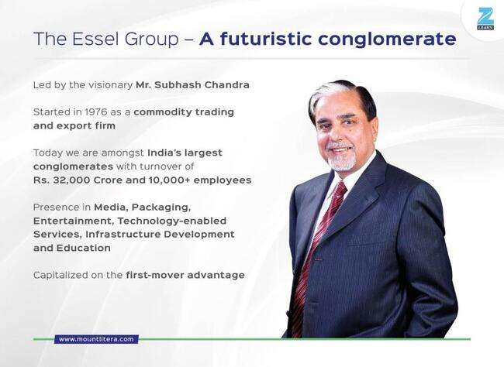

Slide 3
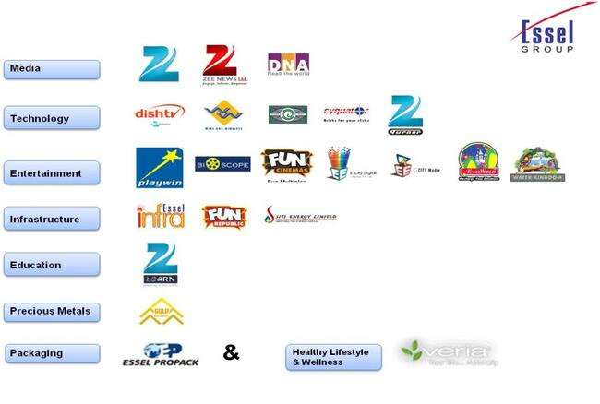

Slide 4
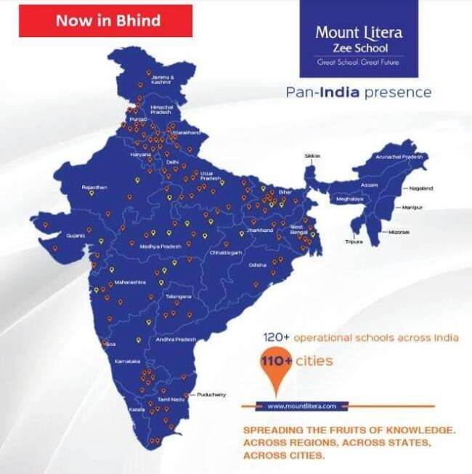

Slide 5

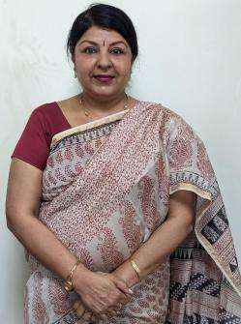
Our Mentor
Ms. Neeru Nayyer
Regional School Director
West India Zee Learn
Notes:
Trainer Notes
Please add the Regional school director details.

Slide 6
Our Belief System
Children are not just roll numbers, they are unique individuals
Every child is talented. Schools just need to figure where that talent lies
A school’s role is to develop whole individual, not just complete the syllabus
Holistic development needs partnership between School and Parents
Schools need an integrated approach centered on the child

Slide 7
Our Philosophy
Every aspect, action and decision at Mount Litera Zee School is governed by a single, simple principle –
“What’s Right for the Child (WRFC)”.
We help students achieve the Emerging Student Profile (ESP) we identified
We nurture the unique potential of children
We do what is right for the child (WRFC)

Slide 8
Our Vision
“ To create an excellent educational institution
synthesising the human values with the
highest quality of teaching – learning using
modern technology-driven tools for preparing
a well-rounded personality for our society.”
To shape global minds on the Indian soil. To ensure this, the school will give every student an access to world class infrastructure and innovative curriculum that promotes the all round development of the child imbibing traditional values.

Slide 9

Emerging Student Profile
Notes:
Trainer Notes
Life Skills
Life Skills are critical for leading life powerfully. Our students emerge out of school with the following life skills. We build life-skills through specially-designed life skills classes, subject-integrated activities, Litera Clubs.
Effective Habits: Our character is a composite of our habits. Mount Litera Zee Schools have a series of programs and activity systems that build effective habits for life.
Media Literacy: Media literacy develops the ability to analyse, critique and effectively use various media to find more information and make informed decisions.
Aesthetic Sense: Aesthetic sense helps students appreciate the beauty that exists around them and enables them to contribute to it.
Metacognition: Metacognition is the skill of knowing how we learn and our unique styles of learning. This empowers us in removing the hidden barriers to our learning.
Risk Taking : This skill enables making your own decisions at the risk of making a mistake, instead of doing what you are told to by others.
Self-Development: An important goal in education is to foster self-reliance and independence. Self-development plans are used for teaching students to complete tasks independently and take an active role in monitoring and reinforcing their own behaviour.
Knowledge
Knowledge, as defined at Mount Litera Zee School, goes beyond the traditional boundaries of academic learning. Our students gain knowledge in the following areas.
Higher-Order Thinking Skills (HOTS) : Students gain real understanding of the subject they take. This enables them to not only retain and apply concepts but also to create new knowledge and ideas from their understanding.
Sports : Students are encouraged to take up sports not only for fitness and health but also to ingrain the values of sportsmanship and teamwork.
Art (Fine Arts, Performing Arts and Applied Arts) : Students develop proficiency in one or more art form.
Entrepreneurship and Financial : Students are encouraged to see the world as an owner. They develop an ability to reach a goal by making choices and planning necessary actions. Students also develop a strong and empowering relationship with money and money management practices.
Core Values
LIFE SKILLS
KNOWLEDGE
CORE VALUES
Core values function as the foundation of leadership. Our students will role model these values. We firmly believe that values cannot be taught in a classroom and that's why we promote an ecosystem that sustains and nurtures these values.
Integrity : Integrity does not only mean being honest. Integrity means being true to oneself and acting in respect of values that one holds. Integrity is displayed in how teachers and students share information, plan and work on assignments, and how the school system handles commitments and decisions.
Open Mindedness : To have an open mind means to be willing to consider or receive new ideas and people with different outlook. It means being flexible, adaptive, and accepting the fact that'others could be right with their differences too'. This value encourages people to seek to understand before expecting to be understood. Cultivating an open mind is another valuable outcome of critical thinking and reasoning; an open mind helps us expand our horizons and be more diverse and inclusive.
Authenticity : It is the alignment of head, mouth, heart, and hands - thinking, saying, feeling, and doing the same thing consistently. This builds trust and sense of cooperation.
Humility : The very basic requirement in a leader because people feel comfortable around a person who pays attention to them and is considerate. Respecting others brings it around to oneself too. Such a person is happier and has more friends. This helps relate to others and their situations and thus deal with them better.
Growth Mindset : Students with a growth mindset believe that their intelligence can be developed over time through their own effort. They know that while not everyone has the same kind of intelligence, everyone can learn and improve. The growth mindset helps children focus on their efforts. They are free to concentrate on becoming smarter rather than looking smart.
Compassion : Inculcating compassion can make our students aware of the world around them and it teaches tolerance towards different cultures and personalities. This enables children to be more sensitive and caring, that in turn leads to better relationships with others as they grow into adulthood.

Slide 10
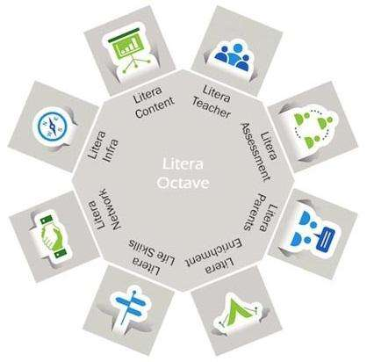
Litera Octave
Unique Child – Centric Teaching Process
Notes:
Trainer Notes
How do we achieve the - Broad based Learning i.e. CONTENT and Behavioral Outcomes, i.e. ESP?
Through the Litera Octave –
1. Litera Teacher - Equipped with the 13 attributes
2. Litera Assessment - Centrally conducted exams for grade 1 – 12
3. Litera Parent - Seminars, PTM and Workshops to make effective partners_+ Career Guidance
4. Litera Enrichment - Litera Content, Co-curricular and extra-curricular activities
5. Litera Life Skills - Activities that hone the Multiple Intelligences
6. Litera Network - Collaborative Learning within the Network
7. Litera Infra - Classrooms enabled with IWB, Computers, Projectors, Labs, Library, MLL APP, TAT Modules, Epfuture
8. Litera Content - Blended Learning Design & Litera Content-on academic & Enrichment programs and Assessment and Evaluation

Slide 11

I CARE
Child abuse free school.
School is concerned about the safety of every child.

Slide 12
LET US INTRODUCE YOU
TO
OUR MANAGEMENT & ACADEMIC TEAM

Slide 13
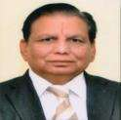
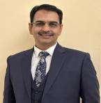
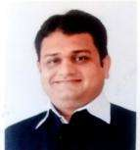
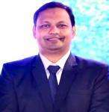
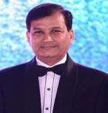
Our Management
Hon’ble Shri Poonamchand Ji Malu
CHAIRMAN
FCA Mr. Girish Malpani
DIRECTOR
Mr. Sanjay Malu
DIRECTOR
Mr. Sushil Soni
DIRECTOR
Adv. Nishant Gandhi
DIRECTOR

Slide 14
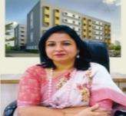
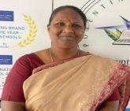
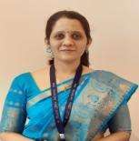
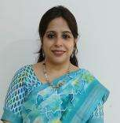
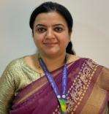
OUR Academic TEAM
Dr. Vandana Paul
PRINCIPAL
Ms. Jayanti Iyer
VICE PRINCIPAL
CO-ORDINATORS
Ms. Dipti Sohoni
Academic Coordinator
(I - III)
Ms. Ifrah Ahmed
Academic Coordinator (IV - VII)
Ms. Megha Pathak
Academic Coordinator (VIII onwards))

Slide 15
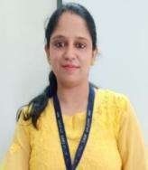
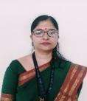
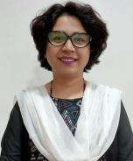
Extended Heads
Ms. Amruta Mokhade
IT Head
Ms. Manjiri Chorghade
Time Table In Charge
Exam Head
Ms. Sarika Thomas
Time Table In Charge
Event In Charge

Slide 16
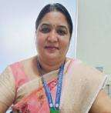
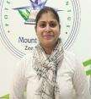
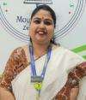
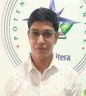
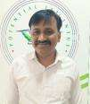
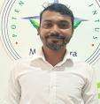
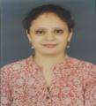
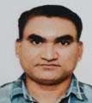
OUR Admin TEAM
Ms. Samta Lakhotia
Relationship Manager
Ms. Sharda Kamble
Front Office Executive
Ms. Debasmita Mukherjee
Admin
Mr. Dharam Sahu
Accountant
Mr. Abhishek Lule
Admin
Mr. Vishal Gokhale
IT Maintenance In charge
Ms. Anthara Gandhi
Front Office Executive
Mr. Parmanand Mate
Fleet In-charge

Slide 17
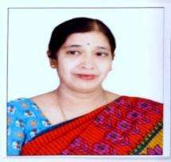
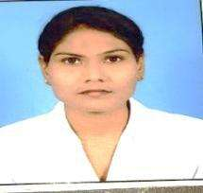
Extended Staff
Ms. Anita Balakrishnan
Special Educator
Ms. Jayshree Meshram
School Nurse

Slide 18
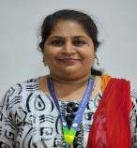
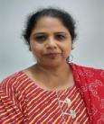
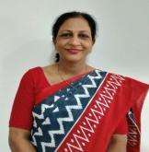
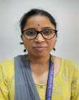
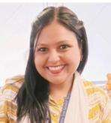
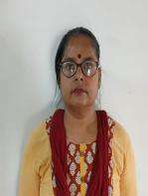
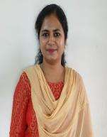
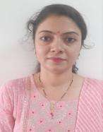
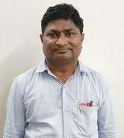
OUR Subject HODs
GRADE I to III
ENGLISH
Ms. Ruchi Shrivastava
HINDI
Ms. Kirti Singh
EVS
Ms. Archana Thool
MATH
Ms. Chaitali Makhe
COMPUTER
Ms. Swati Gedam
GRADE IV onwards
ENGLISH
Ms. Wanda McDonald
EVS/SCIENCE
Ms. Poonam Kurve
HINDI
Ms. Nasreen Hussain
MATH
Mr. Praveen Pannase
COMPUTER
Ms. Amruta Mokhade

Slide 19
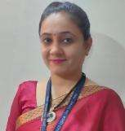
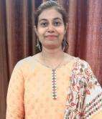
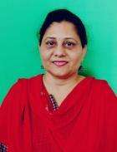
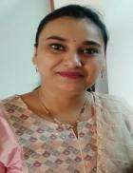
OUR Gradewise Leaders
LEADERS (PRIMARY)
Ms. Ruchi Shrivastava
Leader (Grade I)
Ms. Apeskha Kanojey
Leader (Grade II)
Ms. Archana Thool
Leader (Grade III)
Ms. Priyanka Godghate
Leader (Grade IV)
Ms. Smita Titarmare Leader (Grade V)
Ms. Manmeet Bhange
Leader (VI - VII)
Ms. Manjiri Chorghade
Leader (VIII onwards)

Slide 20
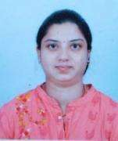

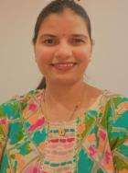
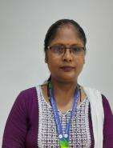
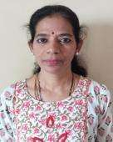
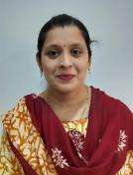
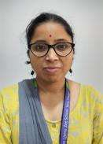
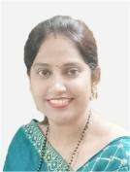
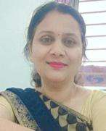
OUR Grade Educators
EDUCATORs GRADE I
Ms. Komal Naidu
Grade Educator I A
Ms. Kirti Singh
Grade Educator I B
Ms. Vinita Sharma
Grade Educator I C
Ms. Manisha Ninave
Grade Educator I D
Ms.Bhavani Gangishetty
Grade Educator I E
Ms. Snehal Thakre
Grade Educator I F
Ms. Chaitali Makhe
Grade Educator I G
Ms. Sarita Gawande
Grade Educator I H
Ms. Priyadarshini Kamble
Hindi Educator

Slide 21
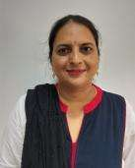






OUR Grade Educators
EDUCATORs GRADE II
Ms. Lata Sakharkar
Grade Educator II A
Ms. Nikita Gandhi
Grade Educator II B
Ms. Sunidhi Basantani
Grade Educator II C
Ms. Suvarna Kale
Grade Educator II D
Ms. Priyanka Purankar
Grade Educator II E
Ms. Suman Purohit
Grade Educator II F
Ms. Shweta Kolhe
Grade Educator II G
Ms. Swati Gedam
Grade Educator II H

Slide 22







OUR Grade Educators
EDUCATORs GRADE III
Ms.Anagha Harkhande
Grade Educator III A
Ms. Sarita Panchware
Grade Educator III B
Ms. Pallavi Kale
Grade Educator III C
Ms. Gayatri Shambarkar
Grade Educator III D
Ms. Pooja Jain
Grade Educator III E
Ms. Bhagyashree Akre
Grade Educator III F
Ms. Priyanka Borkar
Grade Educator III G

Slide 23





OUR Grade Educators
EDUCATORs GRADE IV
Ms.Varsha Parashar
Grade Educator IV A
Ms. Kanchan Manjre
Grade Educator IV B
Ms. Jyoti Katole
Grade Educator IV C
Ms. Preeti Giradkar
Grade Educator IV D
Ms. Minakshi Rathod
Grade Educator IV E

Slide 24



OUR Grade Educators
EDUCATORs GRADE V
Ms.Ashwini Shende
Grade Educator V A
Mr. Devendra Bansode
Grade Educator V C
Ms. Smita Titarmare
Grade Educator V B

Slide 25













COSCHOLASTIC TEAM
Ankita Palaskar
Art Educator
Atul Thakre
Art Educator
Sneha Dondal
Dance Educator
Aditya Gandhi
Dance Educator
Kunal Anandam
Dance Educator
Umesh Barapatre
Music Educator
Bakul Meshram
Librarian
Monika Singh
Librarian
Smita Makde
Librarian
Manoj Kohare
PTI
Akshay Bansod
PTI
Savita Deshmane
PTI
Pranay Umate
PTI

Slide 26

Our TEAM

Slide 27
ACCOMPLISHMENTS BY
VISIONARY LEADERS

Slide 28



“STUDENT OUTREACH CHAMPION AWARD”
by Litera Verse
RECEIVED BY OUR DIRECTOR FCA MR.GIRISH MALPANI

Slide 29
AWARDS RECEIVED BY PRINCIPAL MLZS Ghogali Besa, Dr. Vandana Paul

Slide 30

Received Nachiketa Award for the most innovative idea at the hands of Deputy Chief Minister of Maharashtra
Shri Devendra Fadnavis on the Topic
“To Bring out Harmony through Education”
at Principal’s Conference in 2015

Slide 31

Received Super Nachiketa Award
for effective implementation of
Innovative idea at the hands of
Mr. Sonam Wangchuk ( An Education Reformist and Architect of Sustainable initiatives in Laddakh)
in Principals’ Conference 2019

Slide 32




A Master Trainer of CBSE and has trained more than 200 teachers on the topic “Classroom Management”

Slide 33


Principal MLZS Besa, Dr. Vandana Paul, receiving
“Best Paper Presentation Award” at IPEC 2023

Slide 34



MIMAMSA “A Principal’s Conclave & School Awards”

Slide 35



Principal, Dr. Vandana Paul ma’am guiding young students at MKH Sancheti School on Mental Wellbeing

Slide 36
INFRA @
MOUNT LITERA ZEE SCHOOL,
GHOGALI BESA NAGPUR

Slide 37



Slide 38


Play Area

Slide 39


Science Lab

Slide 40


MATH Lab

Slide 41

Computer Lab

Slide 42



Class Room

Slide 43



Co- Scholastic Activity Areas (Music Room)

Slide 44



Co- Scholastic Activity Areas (Dance Room)

Slide 45




Co- Scholastic Activity Areas (Sports Room)

Slide 46
TEACHER TRAINING GLIMPSES
2023-2024

Slide 47


Staff Orientation & Training ( Zee HO)

Slide 48



Workshops For Teachers

Slide 49



Teacher’s Teaching Aid Exhibition

Slide 50


EP FUTURE (IT) TRAINING BY HEAD OFFICE

Slide 51


Guidance to Teachers by Dr. Kingston D’Souza (Academic HEAD, Zee Learn)

Slide 52


Happy Hour (Pre-Primary & Grade I-II)

Slide 53
Happy Hour
First day of the school is a new experience for every child. It is a transition period for Pre-Primary and Grade I students as they will be introduced to new environment and new Grade Educator for the first time. To make them familiar with this new environment school has planned an Initiative i.e. “Happy Hour”.
During this hour, child will get familiar with Grade Educator, school staff, school premises and new friends to build socio-emotional skills.
Please note the schedule for the same.
21st June, 24th June, 25th June, 26th June, 27th June and 28th June
Timing: 10:00 am to 11:00 am.

Slide 54
Social Connect and Bonding

Slide 55


Parent Teacher Meetings

Slide 56




TEACHERS’ DAY

Slide 57


Staff Picnic

Slide 58
ADMINISTRATIVE SCHOOL MEETINGS

Slide 59



TMC (Transport Management Committee)

Slide 60


EPTA Body Formation

Slide 61



EPTA (Executive Parent Teacher Association)

Slide 62


SMC (School Management Committee Meeting)

Slide 63


POSH (Prevention of Sexual Harassment Policy)

Slide 64

POCSO Meeting
(Protection of Children from Sexual Offenses)

Slide 65


Grievance Redressal Committee

Slide 66
Important Committee Meeting
EPTA formation – 20 July, 2024
EPTA Meet I – 27 July , 2024
EPTA Meet II – 19 October , 2024
SMC Meet I – 31 August , 2024
SMC Meet II-19 April, 2025
POSH Meeting – 06 February, 2025
POCSO Meeting – 20 February, 2025

Slide 67


CLUB ACTIVITIES
1. Fitness Club

Slide 68


2. ECO CLUB

Slide 69



3. Reader’s Club Activity

Slide 70


4. Creative Club

Slide 71


Sports Activities (Self Defence Strategies)

Slide 72

Felicitations for
Scholastic and Co-Scholastic
Achievements of students.

Slide 73

Winners of Super Speakers Competition

Slide 74


Spell BEE Felicitation

Slide 75




National Group song Competition @Saoner & Khasdar Antarashtriya Spardha of Music

Slide 76


Winners of Dance Competition by Cultural foundation and Prerna school in Suresh Bhatt Sabhagruha

Slide 77





Winners of Elocution Competition for English, Sanskrit & Hindi languages
conducted by Somalwar School Maa Umiya Branch Kapsi

Slide 78

DSO Basketball under 14 girls – Second Position

Slide 79

and Informational Visits

Slide 80



Educational Visit Grade 1 & 3 (Railway Museum)

Slide 81



Educational Visit Grade 2 (Raman Science Centre)

Slide 82


Metro Ride (Grade 4)

Slide 83



Educational Visit Grade 5 (Gorewada Zoo)

Slide 84


Orphanage Visit Grade 5

Slide 85
IT INFORMATION AND GUIDANCE
APPS AND SOFTWARE

Slide 86



DIGITAL SUPPORT
MLL Student App Content + Structure +Access Rights
MLL Teacher App+ Structure + Access Rights
EPFUTURE (LMS) for Academic Content + Evaluation support
School Server ( Academic Content)
TAT with MT Educare for Gr 1 to 12
+ SCHOOL SERVER CONTENT
Teaching
Notes:
Introduced MLL app for teachers and students in AY 22-23.
Introduced TAT( Technology Aided Teaching) Modules for Gr 9 to 12 in AY 2022-23
Introduced LMS – EPFUTURE our LMS platform in AY 2022-23
In all the platforms, need based data supported upgradation is in process

Slide 87


Mount Litera Learning App – Installation process
Step 2: After installing the App Fill the Username and Password of your child. ex. SZGN1111.Click Log In.
Step 1: Install the app from Play store /Apple store.
Link will be provided by school.

Slide 88




Mount Litera Learning App – Features
Change Play Back speed option on videos
Bookmark option in front of videos
My Class Section added for Students

Slide 89


Mount Litera Learning App – New Features
GK Subject added for classes 1st to 5th
Scholar Zone added for classes 1st to 3rd (To prepare students for Aptitude & Reasoning, videos along with interactive quizzes are available in “Brain Gym”)
S. Chand Computer Books content is also available under Cloud Manual

Slide 90


My Class Board
*My Class board is a communication app for parents using which they can download school announcements, Class Diary, Class assignments, Events.
* MCB app will be used to pay School Fees.
*The app is available for both Android and iPhones.

Slide 91
ASSESSMENT/ EVALUATION

Slide 92
Evaluation of Grade I & II would be a Periodic Progressive Assessment (PPA). It will be based on regular classroom teaching observations as per NEP guidelines. Related circulars/ messages will be shared with parents well before time.

Slide 93

ASSESSMENT STRUCTURE GRADE III, IV & V
Note: School takes utmost care of students’ academic performance and does not encourage for private tuitions of any subject.

Slide 94






SEA (Subject Enrichment Activities)

Slide 95

SOF Exams – Grade II to VIII
SOF Exam Dates:
IEO- 8 October, 2024
NSO- 12 November, 2024
IMO- 19 November, 2024
For collecting registration
amount of Olympiad exam,
One date will be given from school.
Kindly send the amount on that particular day only as it is difficult to keep a record of the same if not given on that specific day.

Slide 96
PTMs - Primary
PTM 1: 13 July, 2024 (1 to 7)
Paper Showing: 3 August 2024 (Grade VIII)
PTM 2 – 14 September 2024 ( Grade III to 7)
Paper Showing – (Gr VIII) :19 October 2024
Paper Showing PTM (Gr III to VII): 16 November 2024
Open Day (Gr I to VIII): 30 November 2024
Paper Showing (Gr 8) : 21 December 2024
Paper showing – PTM 3 ( Gr III Onwards): 15 February 2025
Open Day (Gr VIII): 22 February 2025
Paper showing – PTM 4 ( Gr III to VII): 19 April 2025
Open Day (Gr 1 & 2): 25 April 2025
Open Day (Gr III to V): 26 April 2025
Open Day (Gr VI): 28 April 2025

Slide 97

COMMENCEMENT OF NEW ACADEMIC YEAR
IMPORTANT POINTS TO NOTE FOR SMOOTH FUNCTIONING OF THE SCHOOL

Slide 98
SCHOOL OPENING DATE
Pre-Primary & Grade I to VII
1st July, 2024
School Timing For Students
PRE-PRIMARY
First Week | 9:00 am to 11:00 am
Second Week Onwards | 9:00 am to 12.30 pm
SATURDAY | All Saturdays HOLIDAY
GRADE I
First Week | 9:00 am to 11:00 am
Second Week Onwards | 9:00 am to 3:10 pm
SATURDAY | All Saturdays 9:00 am to 1:00 pm Except for PTMs or any school activities.
GRADE II Onwards
From first day of school | 9:00 am to 3:10 pm
SATURDAY | All Saturdays 9:00 am to 1:00 pm Except for PTMs or any school activities.

Slide 99
Parent –Teacher/Admin Staff Meeting Time
Designation | Working Time
SCHOOL OFFICE TIMING | 9:00 am to 4:00 p.m.
Teaching Staff | All PTMs All working days 3:30 p.m. to 4:00 p.m. Pre-primary Only Saturday 9 to 11
Co-ordinators | Monday – Friday 3:30 p.m. to 4:00 p.m. All working Saturdays between 9 a.m. to 11 a.m.
PRINCIPAL & VICE PRINCIPAL | 2:30 p.m. to 3:30 p.m.
Note: Please take a prior appointment for any sort of meeting.

Slide 100
Parent to School Communication
For any Admin/Transport related queries, suggestions, feedbacks call on below mentioned school numbers. 0712-4067294 & 0712-2956469
Pre-primary calling hours for teachers 2:00 to 3:00 pm
Please feel free to call Our Co-ordinators between 10:00 am to 11:00 am on numbers mentioned below. After 11:00 am, you may drop a message on whats app. All your messages will be answered within 24 working hours.
Co-Ordinators :
Grade 8th onwards - Ms. Megha Pathak - 7888018189
Grade 4 to 7 – Ms. Ifrah Ahmed - 7888018187
Grade 1, 2 & 3 - Ms. Dipti Sohoni - 7888018183

Slide 101
School to Parent Communication
All school related communication will be done through school portal MCB ONLY.
All circulars and announcements will be posted in MCB daily. Parents are requested to check the MCB app daily.
Grade wise Whatsapp community group will be used ONLY in case of emergency only.

Slide 102


Communication through ALMANAC
For Parent – Teacher communication, please write to Grade Educator through
Almanac on page no. 32 & 33.
Grade Educator/ Subject Education to Parent communication, teacher will send the message through Almanac which has to check and signed daily by the parents. (Almanac pg. no. 34 & 35)

Slide 103

ANNUAL CALENDAR

Slide 104

Book Distribution schedule
Uniforms will be available at D>J> Sales , Shop no12, Pyramid City,
Opposite Mount Litera Zee School,Besa.
Note: We request you to follow the time slot given to avoid any inconvenience.
Also carry a big cloth/jute bag for the kit.

Slide 105

Do not cover the books.
Kindly label the first page of workbooks with child’s name and section.
Kindly label all the belongings, cap, apron, bag, art material and classroom accessories with child’s name.
The Art/Stationery material list will be provided to parents on the book distribution day.
Parents need to submit properly labelled Stationery material on book submission day.

Slide 106

Book Distribution - Primary
(Schedule is already shared on Class Groups)
Learning Resources, Books, notebooks, Book list, Temporary I-card, Escort Card, Van Declaration form, Syllabus booklet and School Reopening circular will be given in the Book Kit.

Slide 107
Book Submission Schedule
As we all know that small students from Pre-Primary & Grade I – II are unable to carry the complete book kit on the first day of school. Considering this we have planned Book Submission for Pre-Primary & Grade I-II.
Timing: 10:00 am to 2:00 pm
Parents need to label all the books and other items (including caps) before submitting.
Dates for book submission of :
Pre-primary : 28th , 29th JUNE (Friday & Saturday)
Grade I : 21st ,24th , 25th , 26th JUNE (Friday, Monday, Tuesday & Wednesday)
Grade II : 21st, 24th , 25th, 26th JUNE (Friday, Monday, Tuesday & Wednesday)

Slide 108




LEARNING RESOURCES

Slide 109


MLZS Enrichment Programs
DCP and FLiP – Grade IV onwards

Slide 110

Dictionary Usage
We encourage the use of Dictionary Grade 3 onwards.
Each child should carry it daily to school.
It is not included in the Book Set, can be purchased from any
stationery.
Need to be purchased only once.

Slide 111


Syllabus Booklet- PRIMARY
Any change in portion will be informed prior.
Portion of G.K. Art and Music will be shared in advance before Term 1 and Term 2.

Slide 112







Learning Resources, Books, notebooks, Book list, Temporary I-card, Escort Card, Van Declaration form, Syllabus booklet will be given along with the Book Kit.
Permanent I-card will be provided soon

Slide 113



MLZS ALMANAC
Parents are request to fill the Declaration pages (Student copy, Teachers copy & Admin copy pg. No. 3 to 8 ) thoroughly and send the duly filled Almanac on the very first day of school.

Slide 114
Happy Hour
First day of the school is a new experience for every child. It is a transition period for Pre-Primary and Grade I students as they will be introduced to new environment and new Grade Educator for the first time. To make them familiar with this new environment school has planned an Initiative i.e. “Happy Hour”.
During this hour, child will get familiar with Grade Educator, school staff, school premises and new friends to build socio-emotional skills.
Please note the schedule for the same.
21st June, 24th June, 25th June, 26th June, 27th June and 28th June
Timing: 10:00 am to 11:00 am.

Slide 115
Period Distribution and Timing (Monday to Friday) Gr 1 & 2
Title | Timing | Duration
Assembly | 9:00- 9:20 | 20 min
Fruit Break | 9:20- 9:25 | 5 min
Support Period | 9:25- 9:45 | 20 min
1st period | 9:45-10:25 | 40min
2nd period | 10:25- 11:00 | 35min
3rd period | 11:00- 11:35 | 35min
Lunch Break | 11:35- 12:10 | 35min
4th period | 12:10- 12:45 | 35min
5th period | 12:45- 1:20 | 35min
6th period | 1:20-1:55 | 35min
Short break | 1:55- 2:00 | 05min
7th period | 2:00- 2:35 | 35min
8th period | 2:35- 3:10 | 35min
 | Total duration | 6 hr. 10 min.

Slide 116
Period Distribution and Timing (Monday to Friday) Gr 3 to 5
Title | Timing | Duration
Assembly | 9:00- 9:20 | 20 min
Fruit Break | 9:20- 9:25 | 5 min
Support Period | 9:25- 9:45 | 20 min
1st period | 9:45-10:25 | 40min
2nd period | 10:25- 11:00 | 35min
3rd period | 11:00- 11:35 | 35min
4th period | 11:35- 12:10 | 35min
Lunch Break | 12:10- 12:45 | 35min
5th period | 12:45- 1:20 | 35min
6th period | 1:20-1:55 | 35min
Short break | 1:55- 2:00 | 05min
7th period | 2:00- 2:35 | 35min
8th period | 2:35- 3:10 | 35min
 | Total duration | 6 hr. 10 min.

Slide 117
School’s Daily Schedule
Reporting Time for Students: 8.45 a.m.
School Assembly: 9:00 am to 9:20 am
Fruit Break
DSP – Day Specific Program and Supporting Period
Three Periods (35 mins each) Grade I & II
Four Periods (35 mins each) Grade III onwards
Lunch Break for Grade I & II – 11:35 am to 12:10 pm
Lunch Break for Grade III onwards – 12:10 pm to 12:45 pm
Three Periods (35 min each) Grade I & II
Two Periods (35 min each) Grade III onwards
Short Break
Two Periods Grade I & II , Grade III onwards
Parents to send one full meal for long break, fruits for fruit break and dry snacks for short break respectively. Parents to please send sufficient water, spoon and napkin with the tiffin.
Parents are requested to send healthy meal from Monday to Friday.
Saturday is a choice day for students.

Slide 118

Suggested Menu Card
Mount Litera Zee School
Besa, Nagpur
Breakfast Menu
Note : This is a suggested Menu. If your child is allergic to any particular food kindly don’t send it.

Slide 119
Subjects Taught
Subjects for I - II
1. English Language / Literature
2. Hindi
3. Mathematics
4. EVS
5. Computer
6. Marathi (Oral)
7. GK and Life Skill
8. Art and craft
9. Sports
10. Dance
11. Music
12. Library

Slide 120
Subjects Taught
Subjects for III - V
1. English Language / Literature
2. Hindi
3. Mathematics
4. EVS
5. Computer
6. Marathi
7. GK and Life Skill
8. Art and craft
9. Sports
10. Dance
11. Music
12. Library
(Grade 4 onwards DCP & Flip)

Slide 121








Regular School Uniform
Boys
Girls
Olive Green Shirt and Navy Blue Shorts or Trousers,
Black Velcro shoes, Navy blue socks, Tie and Belt.
School cap
For all
Olive Green Shirt and Navy Blue Tunic / Skirt and tights/shorts.
Black Velcro shoes, Navy blue socks, Tie and Belt, Black hairbands/ clips.
Tie
Shirt
I – IV
Shorts
V onwards
Trousers
Shirt
Skirt – I to IV
V onwards
Tunic
Cycling
shorts
Regular Uniform | House Uniform
Monday, Tuesday, Thursday, Friday | Wednesday & Saturday
Note: *Make sure your child wears the ID card everyday.
**On the day of PTM students should come in school uniform .

Slide 122




Winter Uniform COMMON for Boys and Girls
Winter Uniform
grade I to IV
Winter Uniform
grade V
Scout and Guide Uniform :Thursday
GIRLS:
VI to VIII
BOYS:
VI to VIII

Slide 123




House System & Uniform (Primary)
House colour T - Shirt and Blue Track Pants + Black shoes, Navy blue socks.
Blue House
Christopher
Columbus
Red House
Leonardo
Da Vinci
Yellow House
Albert
Einstein
Green House
Mahatma
Gandhi
Wednesday and Saturday :- House Uniform

Slide 124

HOUSE UNIFORM - PRIMARY

Slide 125
Birthday Policy
If the students want to celebrate their birthday in school, they may bring any small chocolate of value Rs. 2 or Rs. 5 . In case if it is found having more value, the entire packet will be returned.
Parents are requested not to give any fancy/gold/silver gift or token of gratitude to the educators.
No birthday parties will be held in school.
No birthday gifts or return gifts will be exchanged with students.
Private birthday invitations should not be sent in school.
Send your child in decent dress along with I-card.
Long gowns/frocks and fancy items are not allowed.

Slide 126
Innovation of Session 2024-25

Slide 127
DSP
Day Specific Plan- (Grade 1 onwards)
MORAL MONDAY To inculcate Sanskar or values in children. | TRAVEL TALE TUESDAY Students will share their travelling experience(in or out of town). | WISDOM WEDNESDAY Students will talk about great leaders. Their struggles and achievements.
THOUGHTFUL THURSDAY Debate and discussion on current topics by students. | FEEL GOOD FRIDAY Students to practice stretching and breathing exercises to unwind and relax. | SPORTY SATURDAY Mass PT & meditation will be conducted.

Slide 128
Expectations from Parents
Show respect and support for your child, the educators, and the school.
Do not talk ill about any educator or school authority in front of the students.
Have positive attitude towards the school and cooperate with the teachers towards the betterment of the student.
Develop reading habit in your child by example.
Support the school’s discipline policy.
Encourage the child to be regular and punctual in attending the school.
Requests for half days should not be made once the child has reached school until it is an emergency situation.

Slide 129
Pledge by Mount Literans
I will trim my hair every month.
I will cut my nails on Sundays.
I will wash my school bag, tiffin bag, tie & I-card lanyard every fortnight.
I will organize my bag everyday.
I will wear Clean & Ironed Clothes daily.
I will never be late to school.
I will always respect my parents and teachers and obey them.

Slide 130






Transport Facility

Slide 131
MODES OF TRANSPORT
1. School Transport Facility is available in school.
Fleet In-charge – Mr.Parmanand Mate and Mr.Umeshwar Barapatre
2. Parents availing private van for their ward are requested to fill the Van Declaration Form (to be given with the book set) and submit it compulsorily on the first day of school.
3. Parents/Van drivers coming to collect their ward to please carry Escort card.
4. To keep a track of students coming to school by van, on the First day of school, please send the students at 9.30 am. School will take photograph of van students with their respective van and van drivers on the first day itself (For safety purpose).

Slide 132
Transport Facilities provided by school-
All the buses are approved by RTO as per the Motor Vehicle Act
specially made for school buses.
> Drivers and Lady Conductors wear Uniform and follow safety
rules.
> GPRS system with camera & panic button are installed in each
buses.
> Seat adjacent to jack knife door are rear facing to prevent the children
from falling through the door.
> A fully equipped First-Aid Box is there in the bus.
All the buses have Speed Governor approved by RTO as per the
Motor Vehicle Act specially made for school buses.
> Special training is provided to the drivers and conductors and review
would be taken after every quarter.
> GPRS tracking app access is provided to the parents.
> We provide Messaging Notification on Pick-up and Drop point to
the Parents.

Slide 133




GPRS tracking application access

Slide 134

Sample Bus Route Planning

Slide 135


Know more about us
School Website :
www.mountliteraghogali.com
Facebook Page:
https://www.facebook.com/mountliterabesa/
You Tube Channel :
https://www.youtube.com/channel/UCAR4GcspgghrllvzTncGgmg
Instagram handle https://instagram.com/mlzs_besa?igshid=MzRlODBiNWFlZA==

Slide 136
Teachers and Parents together
give children
Roots to grow
and
Wings to fly high.
Thank you !!

